Slide 1

2nd Intermediate Period
c. 1640–1540 BC
New Kingdom Architecture
18th-20th Dynasties
c. 1549-1069 BC

Slide 2
Lesson Info and PowerPoint: https://www.teachercurator.com/
https://www.facebook.com/teachercurator/

Slide 3
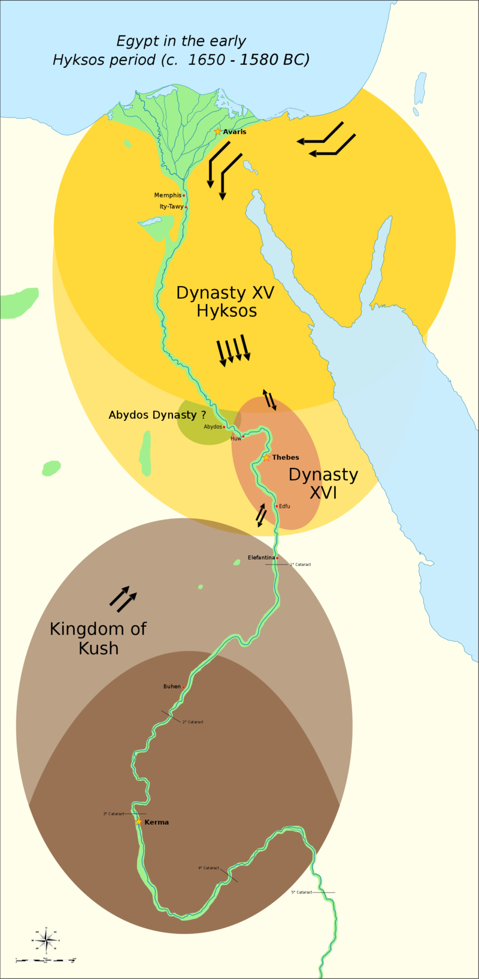
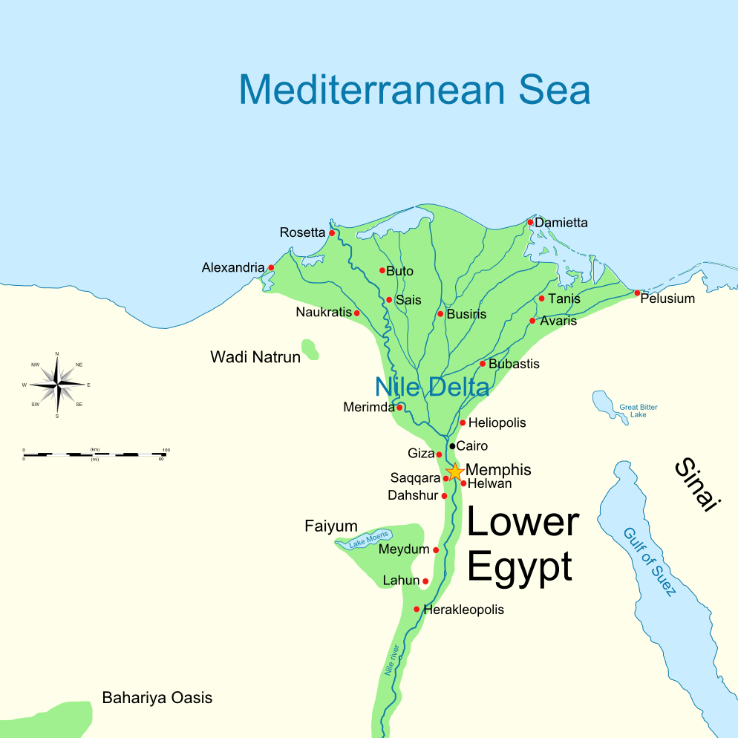
2nd Intermediate Period c. 1640–1540 BC he 2nd Intermediate Period marks a period when ancient Egypt fell into disarray for a second time, between the end of the Middle Kingdom and the start of the New Kingdom https://en.wikipedia.org/wiki/Second_Intermediate_Period_of_Egypt

Slide 4
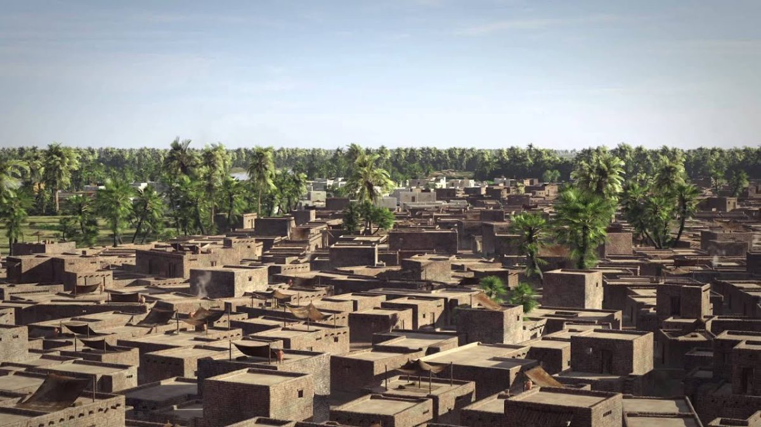
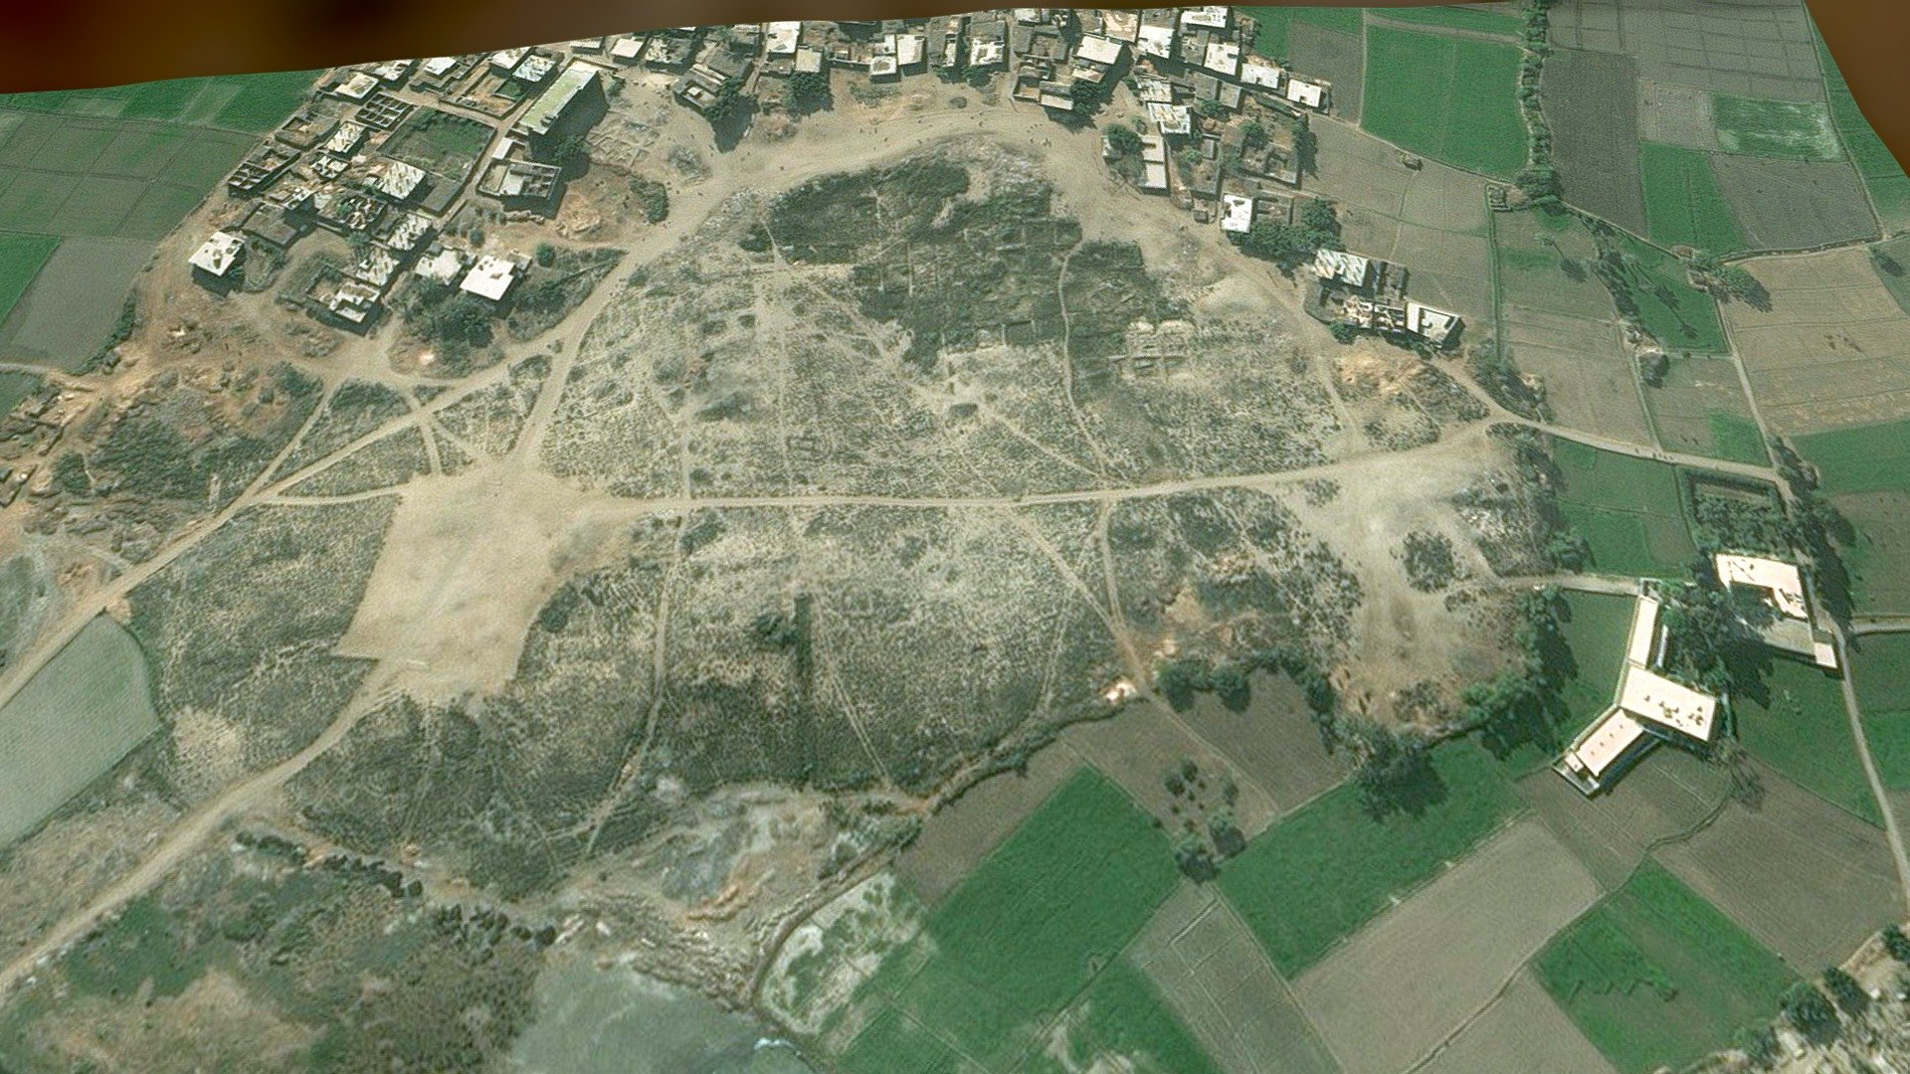
Avaris was the Hyksos capital of Egypt located at the modern site of Tell el-Dab’a in the northeastern region of the Nile Delta. Excavations have shown that it was a well-developed center of trade with a busy harbour catering to over 300 ships. Artefacts excavated at an Hyksos city temple produced goods from all over the Aegean world, including a Minoan-like wall paintings similar to those found in Crete at the Palace of Knossos. https://landioustravel.com/egypt/ancient-egyptian-towns/avaris/ https://sketchfab.com/3d-models/avaris-tell-el-daba-ancient-egyptian-hyksos-87561a1256c34291a2a0d35040e6614e

Slide 5
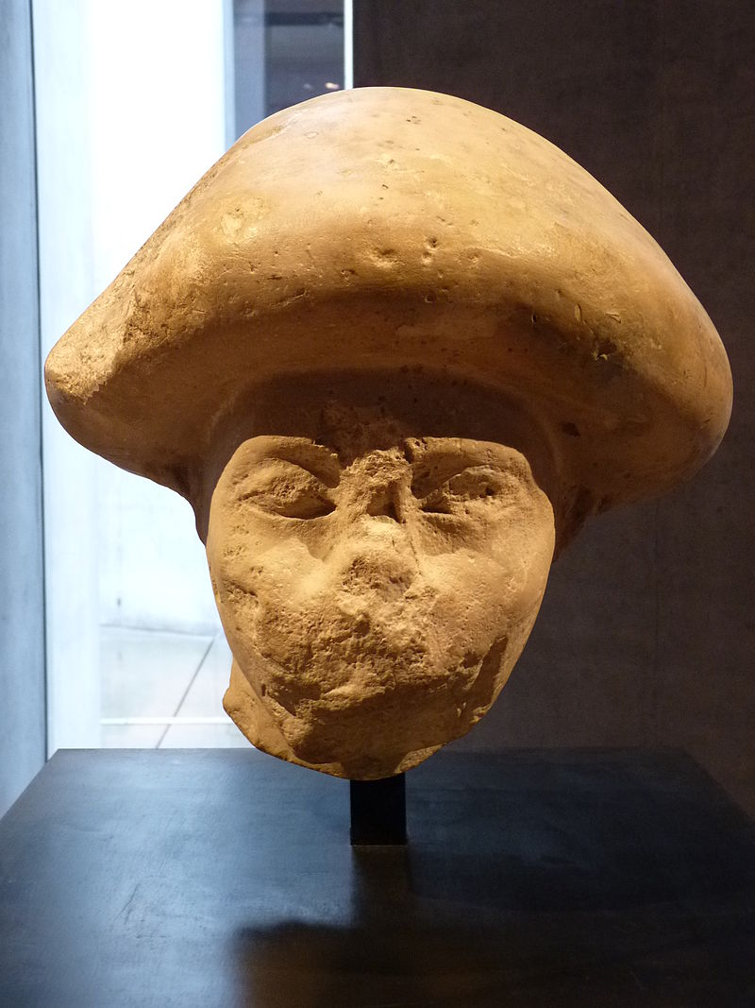
Hyksos Official wearing the "mushroom-headed" hairstyle also seen in contemporary paintings of Western Asiatic foreigners, 2nd Intermediate Period, 1800–1750 BC, from Avaris, the capital of the Hyksos, Limestone, Height: 35 cm, Staatliches Museum Ägyptischer Kunst, Munich Germany https://en.wikipedia.org/wiki/Staatliche_Sammlung_f%C3%BCr_%C3%84gyptische_Kunst

Slide 6
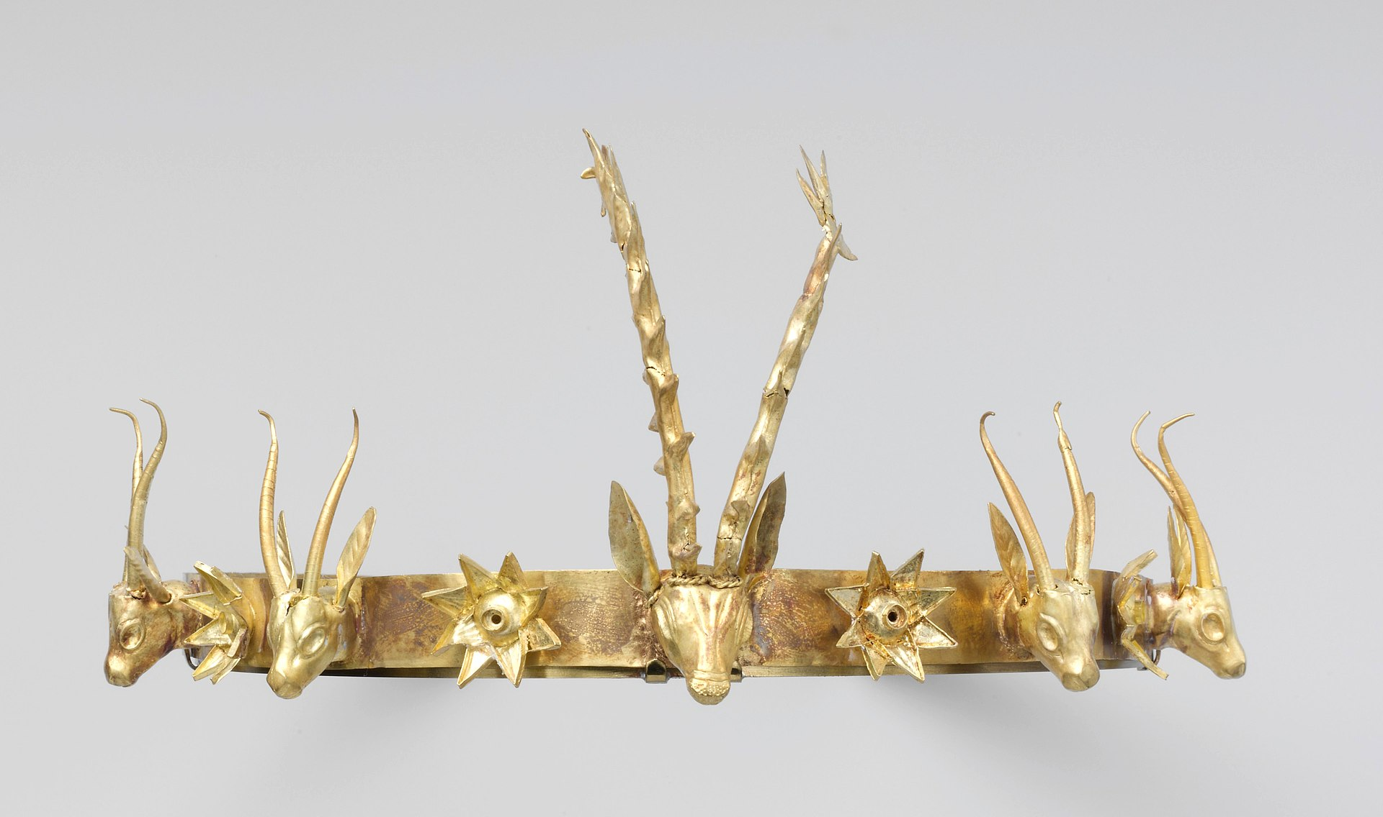
Headband with Heads of Gazelles and a Stag Between Stars or Flowers, ca. 1648–1540 BC, 2nd Intermediate Period, , Date: ca. 1648–1540 BC, Gold, Height of central stag: 8.9 cm, the MET, NY, USA https://commons.wikimedia.org/wiki/File:Headband_with_Heads_of_Gazelles_and_a_Stag_Between_Stars_or_Flowers_ca._1648%E2%80%931540_BCE.jpg

Slide 7
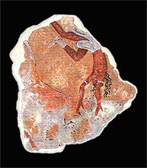
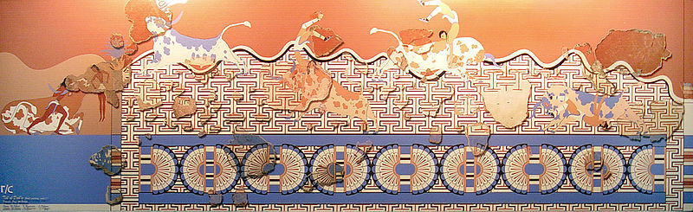
Minoan frescoes of Bull-Leaping from Avaris (Tell el-Daba), New Kingdom, 18th Dynasty, 1530 BC, Fresco Painting, Length: 40 cm, Supreme Council of ntiquities, Tell et-Daba, Egypt
According to the archaeologists, the Minoan fresco in Tell el-Dab'a indicates "an encounter on the highest level must have taken place between the courts of Knossos and Egypt.“ https://www.greecehighdefinition.com/blog/minoan-frescoes-from-tell-el-daba-egypt https://www.wikiwand.com/en/Minoan_frescoes_from_Tell_el-Daba

Slide 8
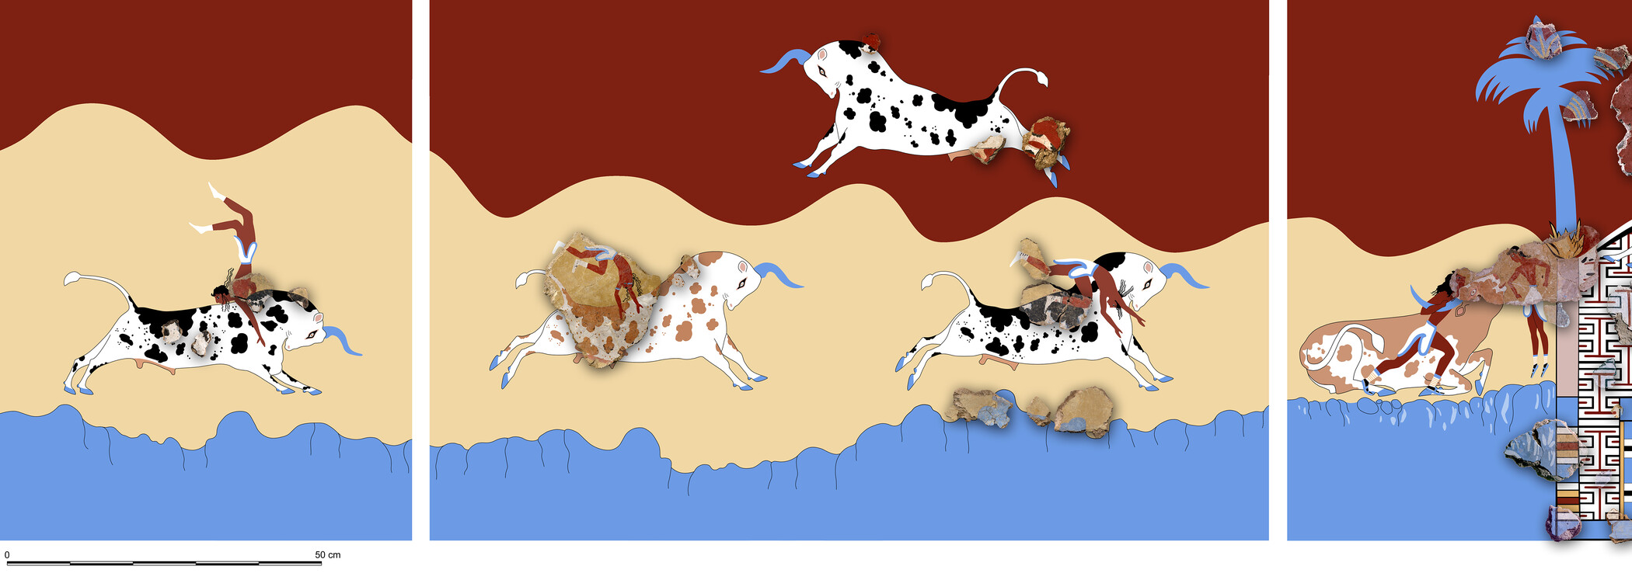
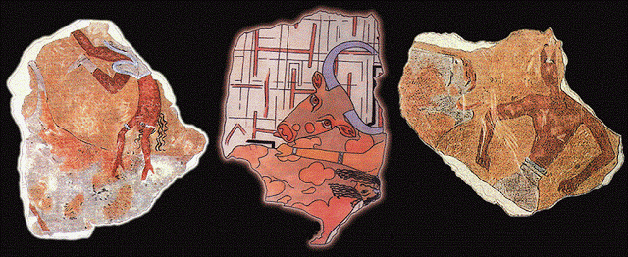
https://www.oeaw.ac.at/en/oeai/research/prehistory-wana-archaeology/archaeology-in-egypt-and-sudan/tell-el-daba-late-minoan-wall-paintings

Slide 9
Pharaoh Seqenenre Tao
Pharaoh Kamose
Pharaoh Ahmose I
The end of the
2nd Intermediate Period
The beginning of the
New Kingdom

Slide 10
Seqenenre Tao, called 'the Brave,’ was Pharaoh of the
Theban 17th Dynasty (Reign: 1560 or 1558–1555 BC),
the last Egyptian Dynasty of the 2nd Intermediate Period.
With his queen, Ahhotep I, he fathered two sons,
Kamose, his immediate successor and the last pharaoh
of the 17th Dynasty (Reign: c. 1555–1550 BC),
and Ahmose I who was the first pharaoh of the
18th Dynasty (Reign: c. 1550–1525 BC)
and the founder of the New Kingdom Period.
Seqenenre Tao is credited with starting the opening
moves in a war of revanchism against the Hyksos, which
saw the country completely liberated during the reign
of his son Ahmose I.

Slide 11
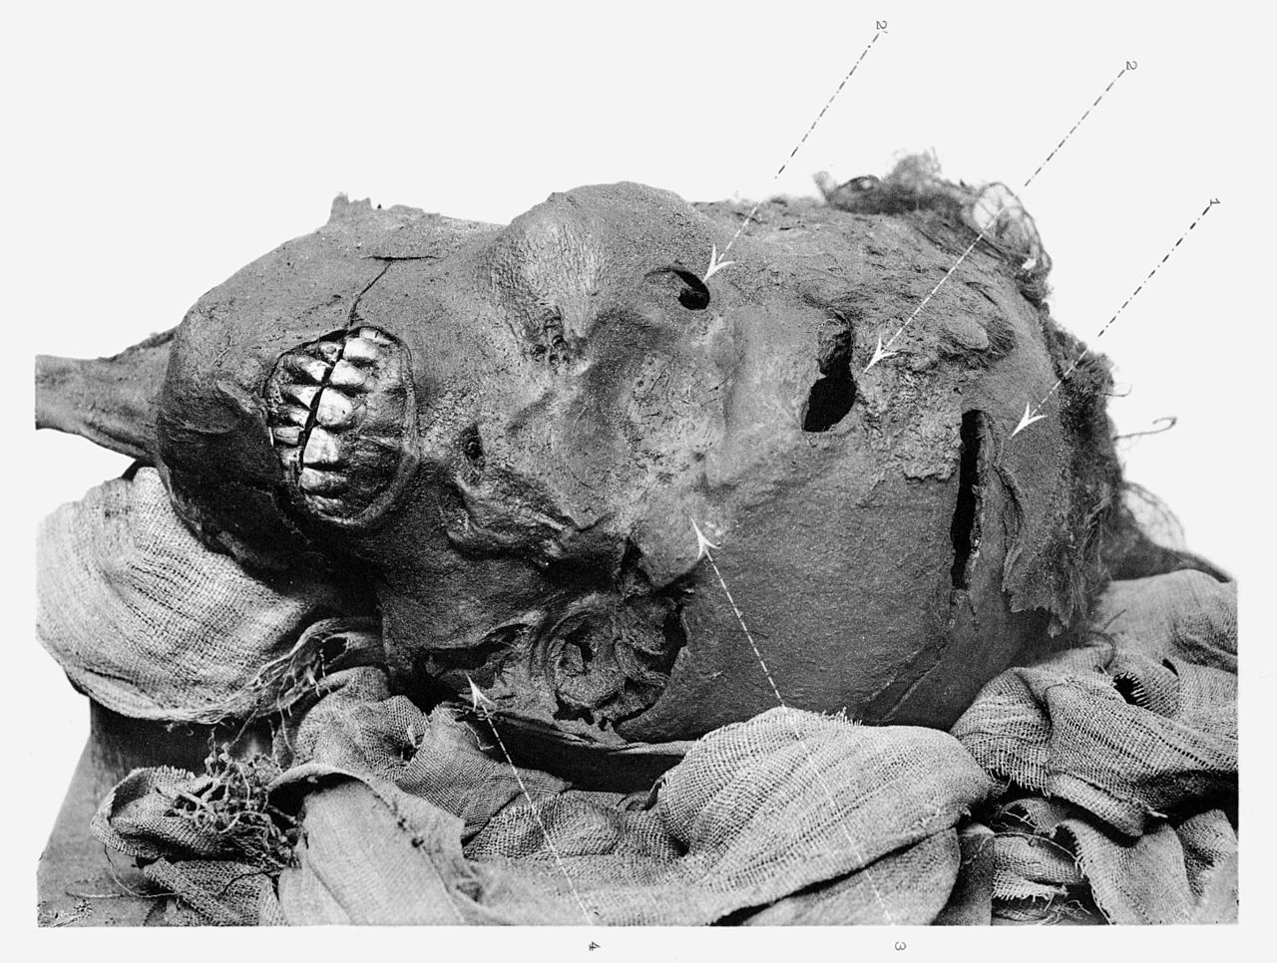
Seqenenre Tao, called 'the Brave,’ was Pharaoh of the Theban 17th Dynasty (Reign: 1560 or 1558–1555 BC), the last Egyptian Dynasty of the 2nd Intermediate Period.
As the wounds in the mummified head of Seqenenre indicate, the Pharaoh probably died in a battle against the Hyksos. https://commons.wikimedia.org/wiki/File:Sequenre_tao.JPG

Slide 12
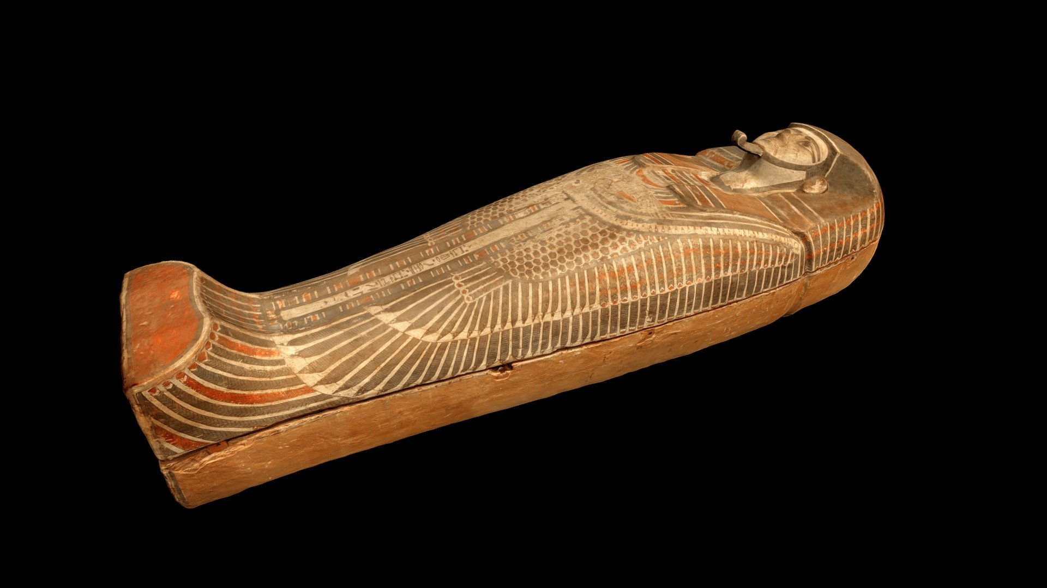
Wooden coffin of the 17th Dynasty Pharaoh Kamose, son of Pharaoh Seqenenra Taa in the Egyptian Museum, Cairo. Kamose successfully continued the war to expel the Hyksos kings started by his father Seqenenra Taa. https://sketchfab.com/3d-models/coffin-of-pharaoh-kamose-5611725214f44e01920e0489f48b894e

Slide 13
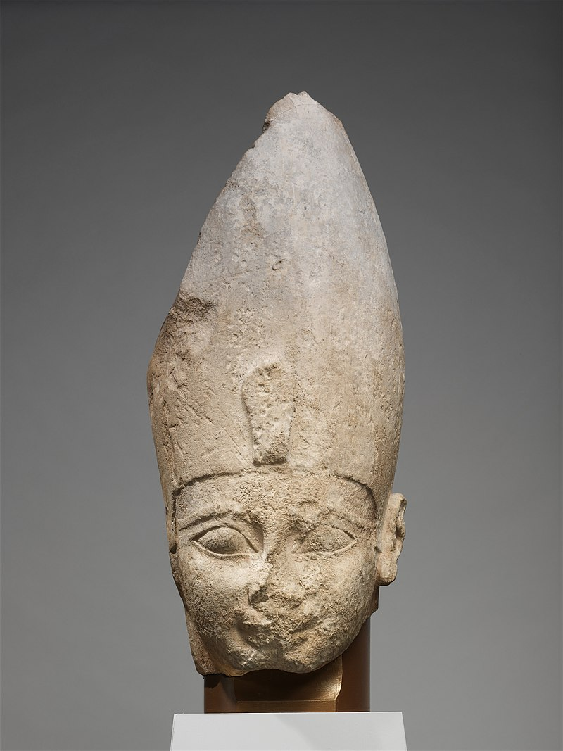
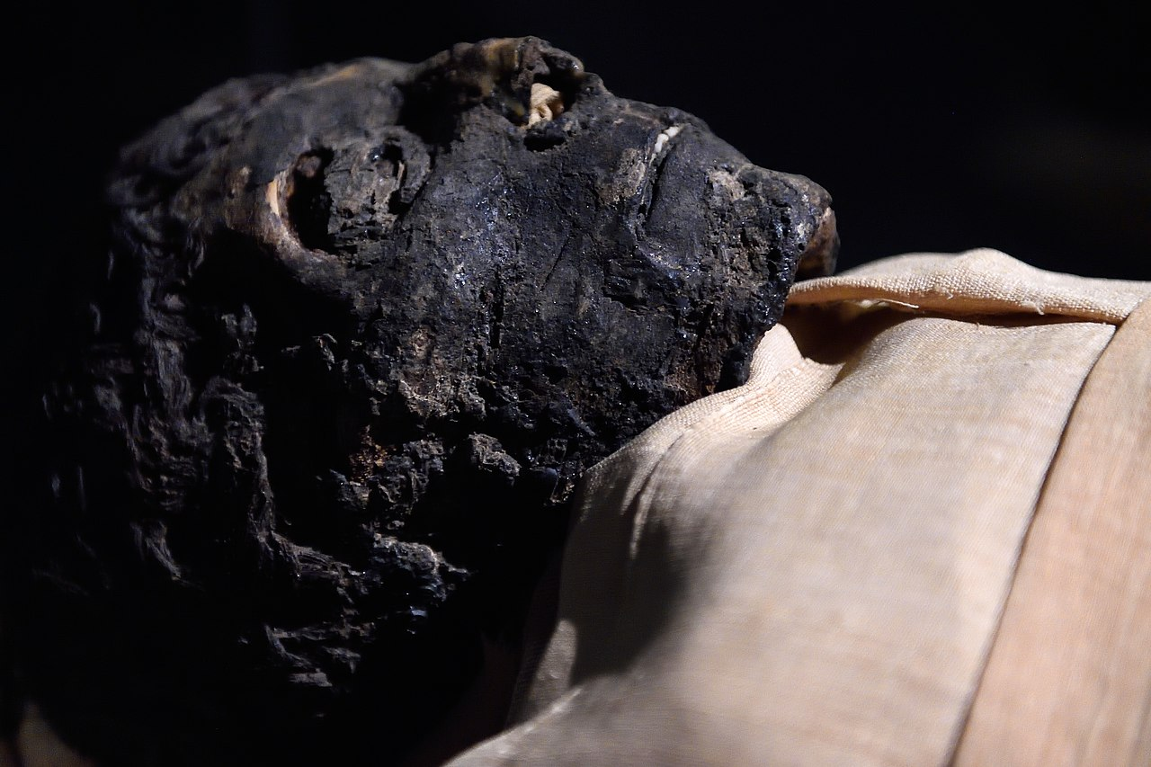
Head of Ahmose I, circa 1550 –1525 BC, New Kingdom, 18th Dynasty, Limestone, H. 56 cm, the MET, NY, USA
The Mummified Head of Ahmose I, Luxor Museum, Egypt https://commons.wikimedia.org/wiki/File:Head_of_Ahmose_I_MET_DP140854.jpg https://commons.wikimedia.org/wiki/File:Ahmose_Mummy_at_Luxor_Museum_in_Luxor_Egypt.jpg

Slide 14
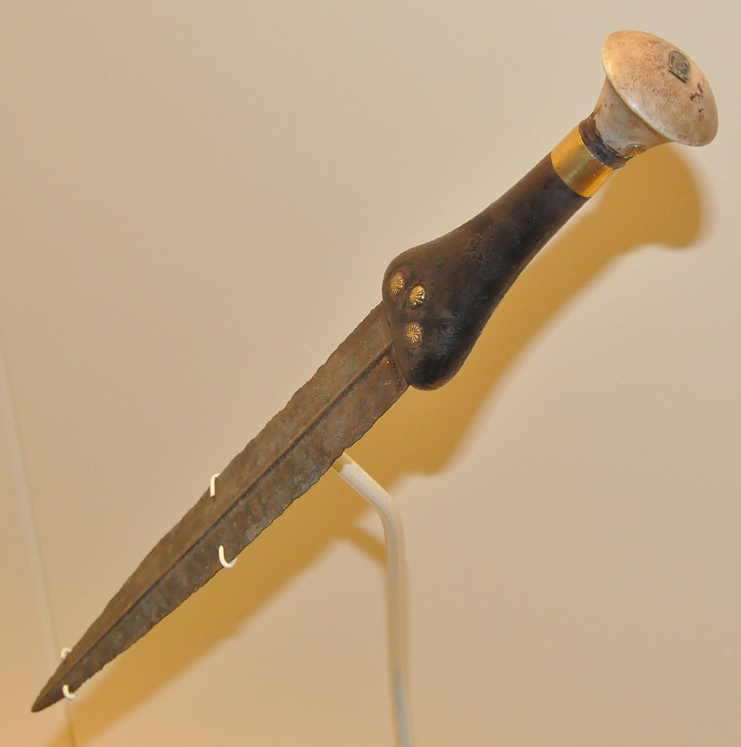
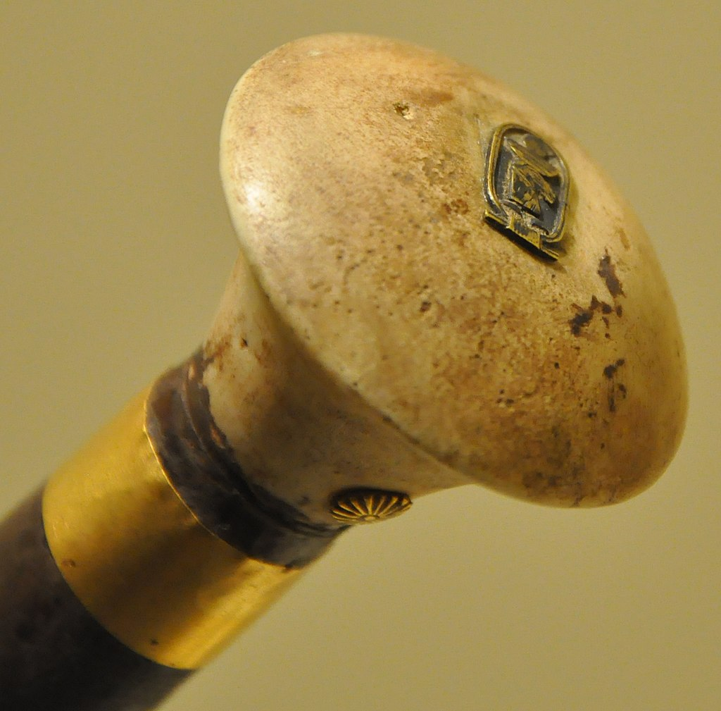
Dagger bearing the name Ahmose I and detail of the Pharaoh’s cartouche on the dagger’s pommel, c. 1560 BC, Cast bronze blade, ebony grip and travertine pommel, gold band and cartouche, 34.4 × 4.1 cm, Royal Ontario Museum, Canada https://commons.wikimedia.org/wiki/File:Dagger_bearing_the_name_of_Ahmose_I.jpg https://en.wikipedia.org/wiki/Ahmose_I#/media/File:Pommel_of_the_dagger_bearing_the_name_of_king_Ahmose.jpg

Slide 15
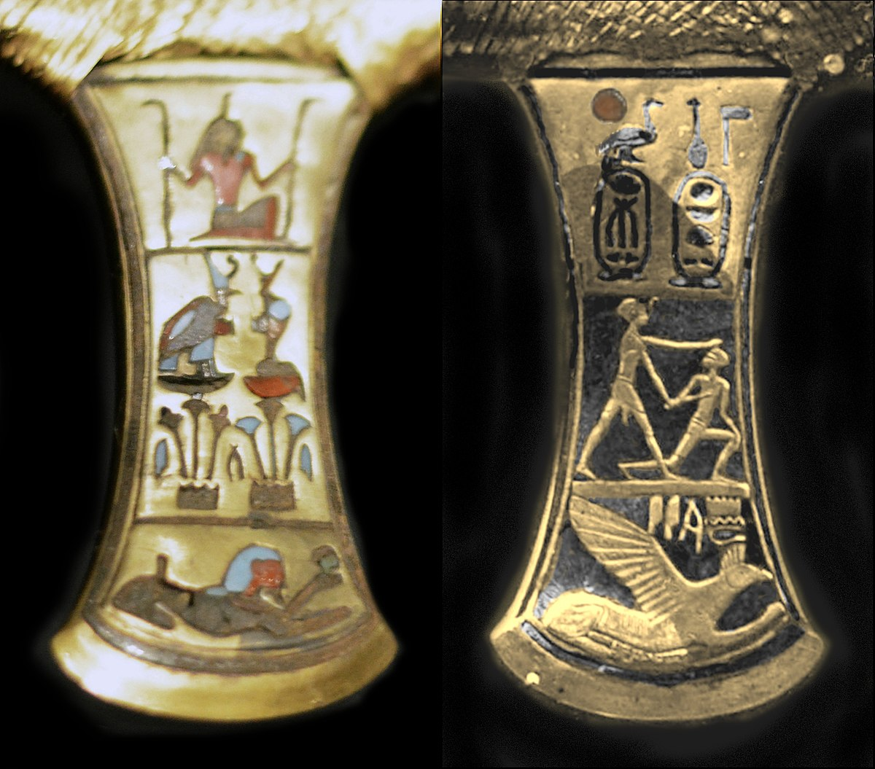
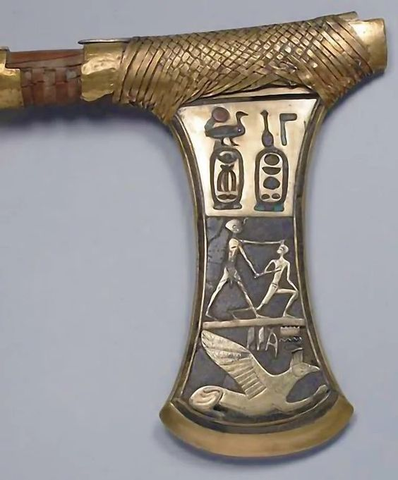
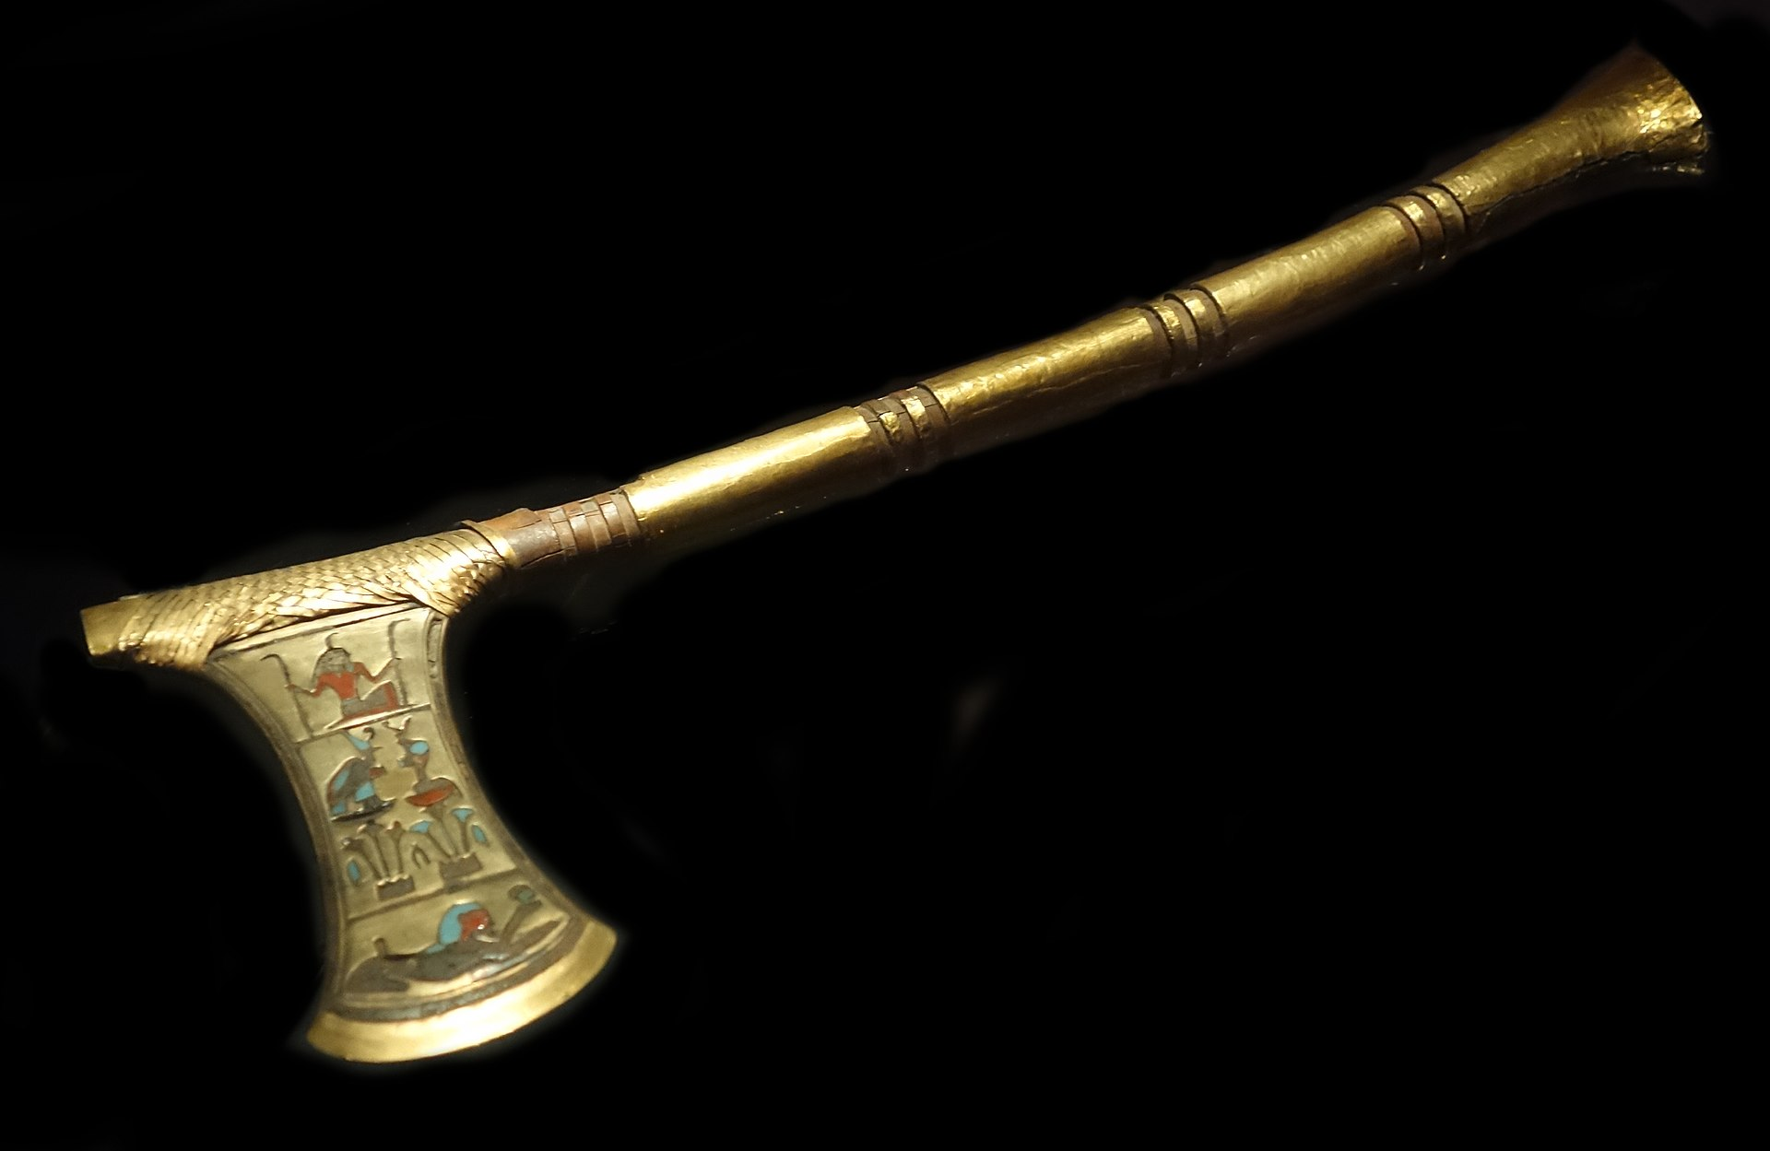
Ceremonial Axe in the name of Ahmose I, treasure of Queen Ahhotep II, Luxor Museum, Egypt https://en.wikipedia.org/wiki/Ahhotep_II#/media/File:Ceremonial_axe_of_Ahmose_I._Luxor_Museum_(background_retouched).jpg https://gr.pinterest.com/pin/632333603943648573/ https://commons.wikimedia.org/wiki/File:Ceremonial_axe_of_Ahmose_I_%28both_sides%29.jpg

Slide 16
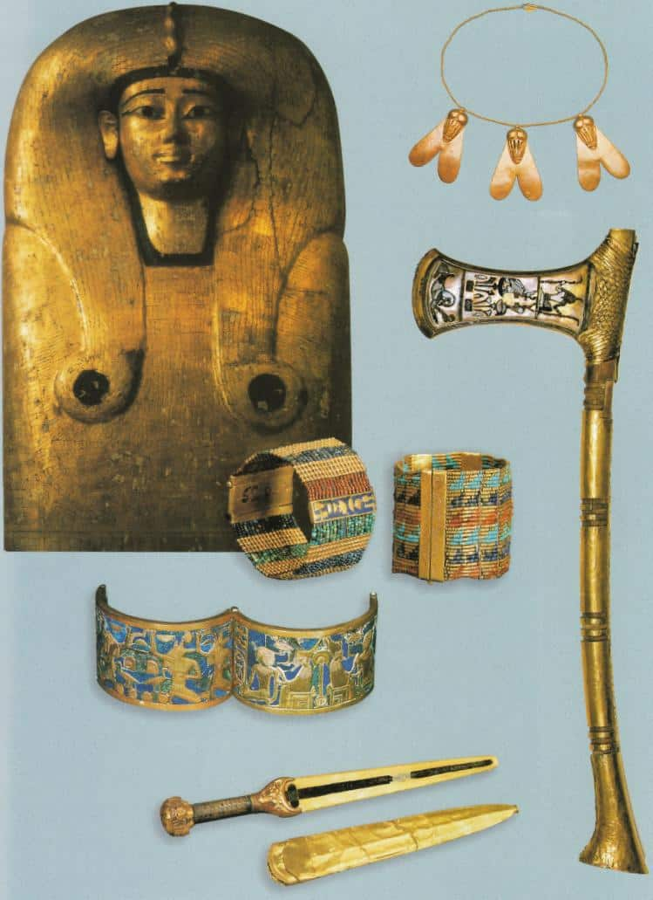
Artifacts recovered from the tomb of Queen Aahhotep I, discovered at Dra Abu el-Naga, in Western Thebes by Auguste Mariette in 1859, Luxor Museum, Egypt https://historycollection.com/16-remarkable-but-frequently-overlooked-women/12/

Slide 17
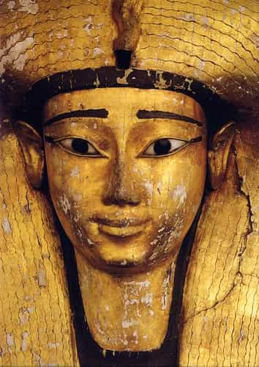
Artifacts recovered from the tomb of Queen Aahhotep I, discovered at Dra Abu el-Naga, in Western Thebes by Auguste Mariette in 1859, Luxor Museum, Egypt https://historycollection.com/16-remarkable-but-frequently-overlooked-women/12/ https://historicaleve.com/treasure-of-egyptian-queen-ahhotep/

Slide 18
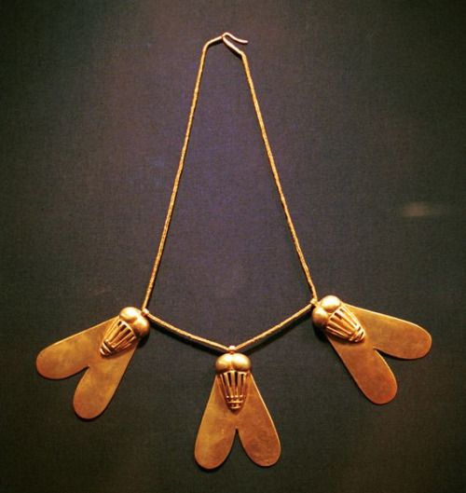
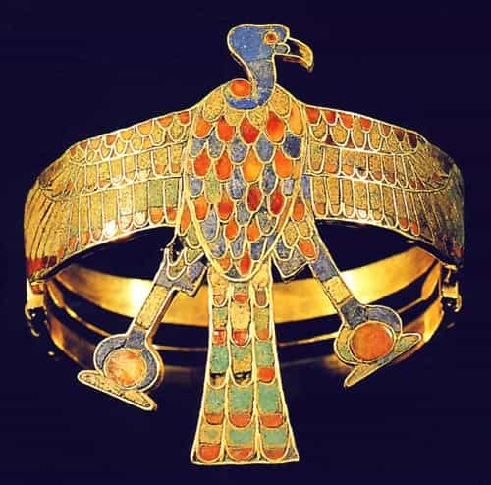
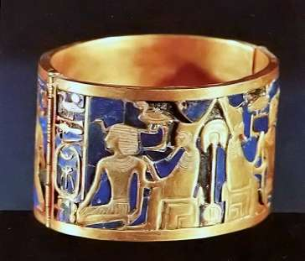
From the Treasure of the Egyptian Queen Ahhotep, 17th Dynasty, Luxor Museum, Egypt https://historicaleve.com/treasure-of-egyptian-queen-ahhotep/ https://gr.pinterest.com/pin/470626229792773730/

