Slide 1

Impressiomism
Why, What and How

Slide 2
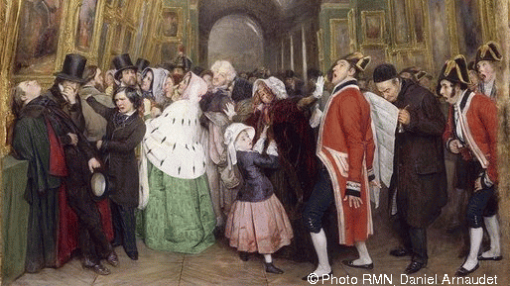
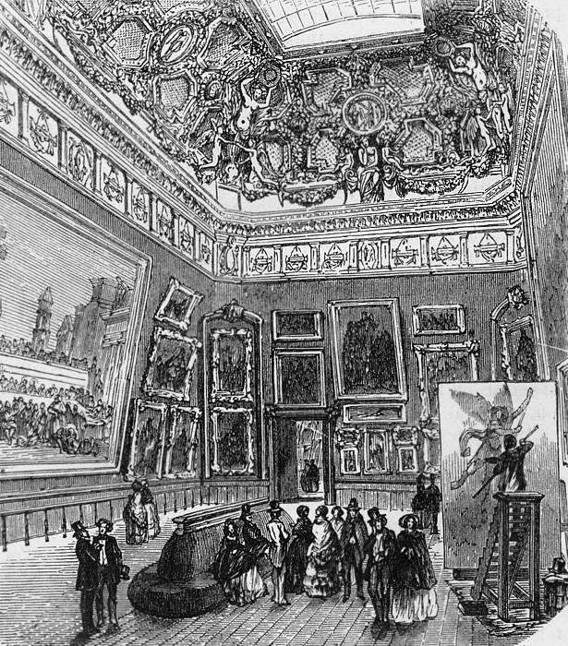


Slide 3
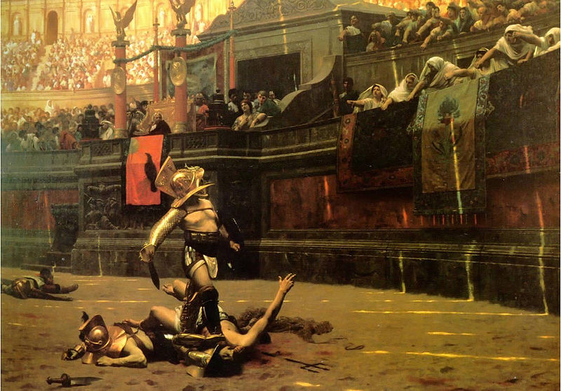
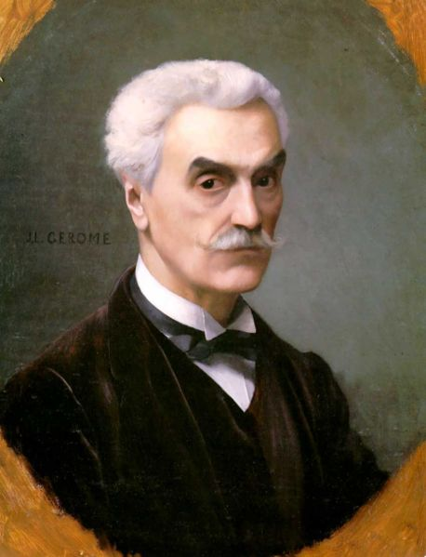
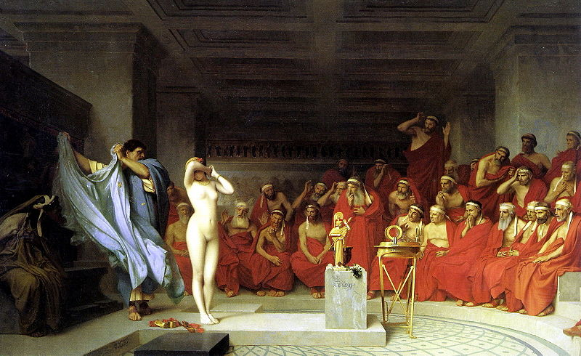
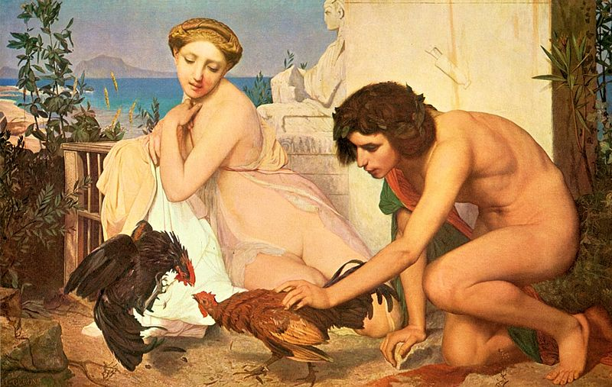
Jean-Léon Gérôme
1824 – 1904

Slide 4
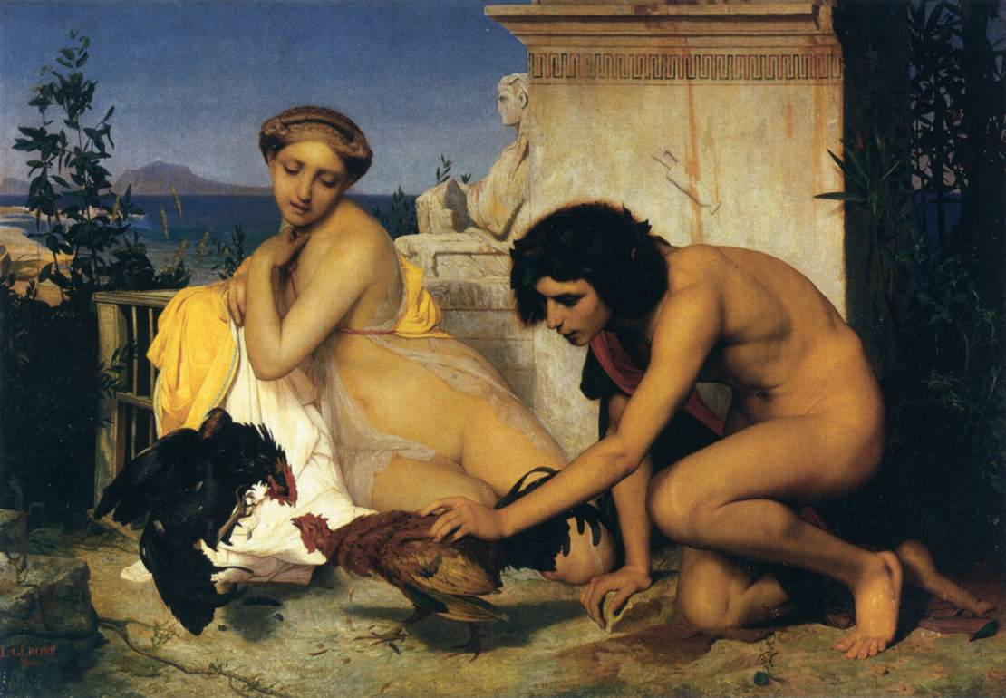
Young Greeks at a Cockfight, 1846, Oil on canvas, 143 x 204 cm, Musée d'Orsay, Paris https://www.wga.hu/frames-e.html?/html/g/gerome/index.html

Slide 5
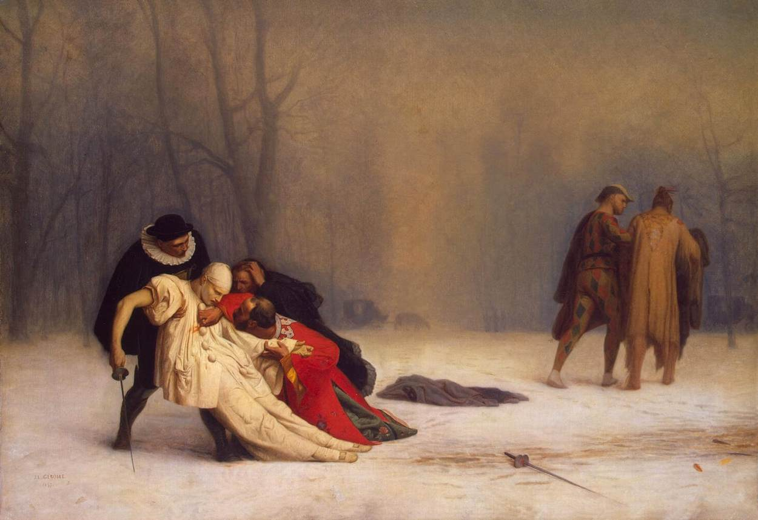
Duel after a Masked Ball, 1857, Oil on canvas, 68 x 99 cm, The Hermitage, St. Petersburg https://www.wga.hu/frames-e.html?/html/g/gerome/index.html

Slide 6
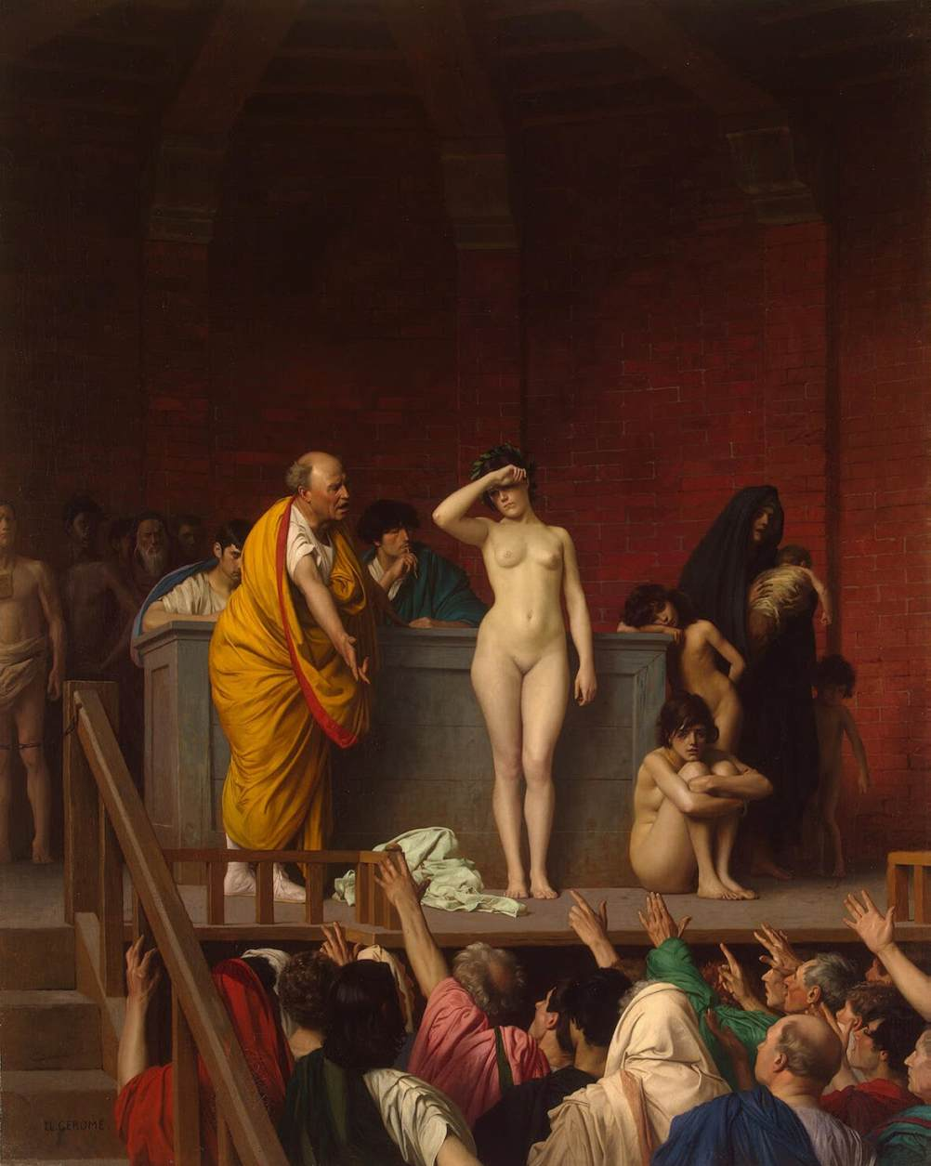
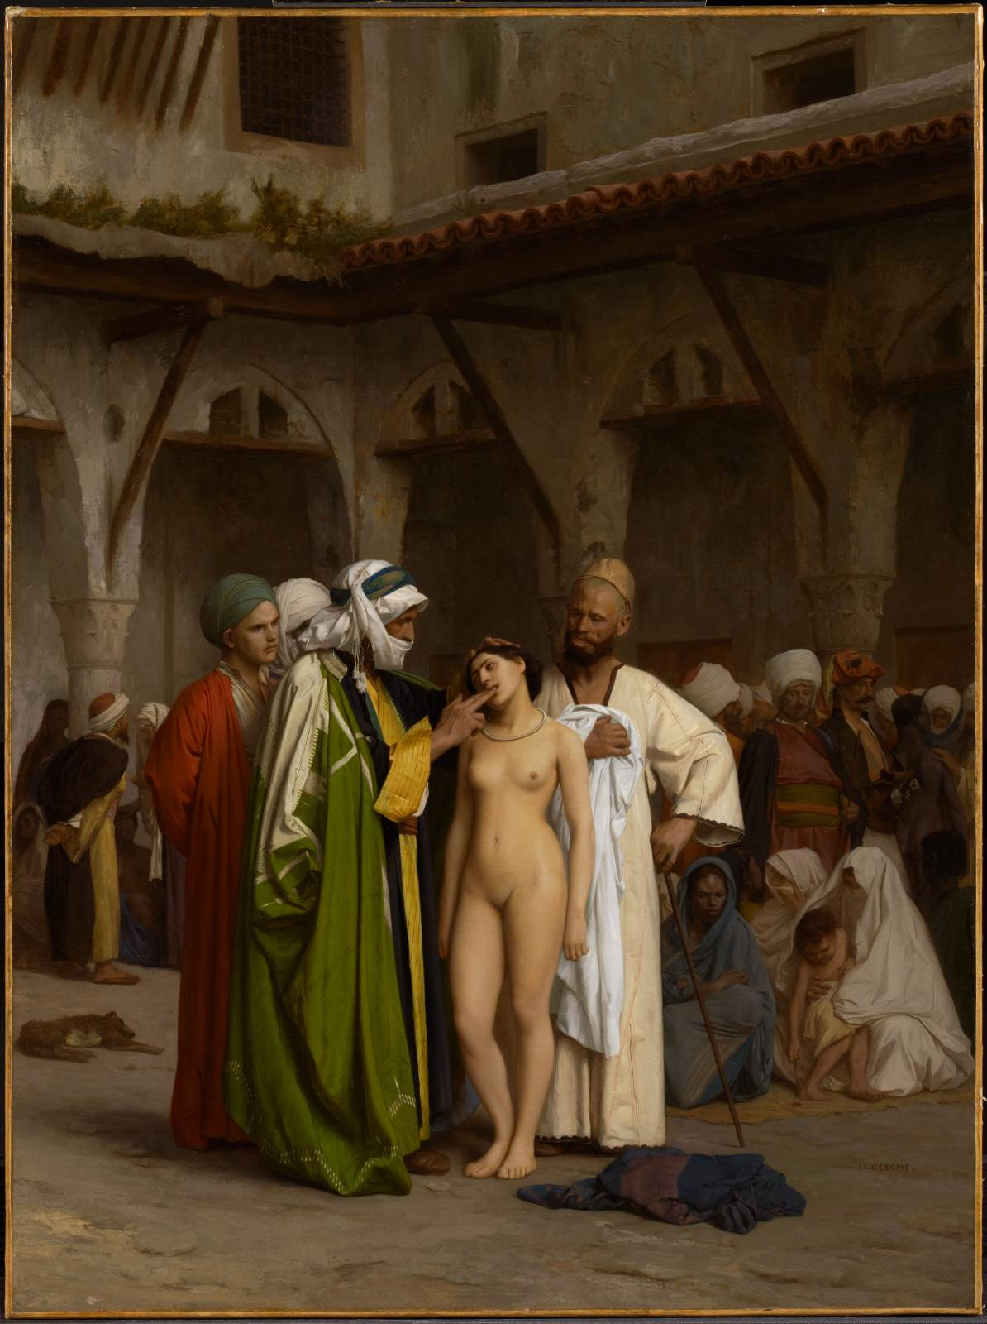
Slave Market in Rome c. 1884
Oil on canvas, 92 x 74 cm
The Hermitage,
St. Petersburg
Slave Market
1866
Oil on canvas, 85 x 63 cm
The Clark Art Institute, Williamstown https://www.wga.hu/frames-e.html?/html/g/gerome/index.html

Slide 7
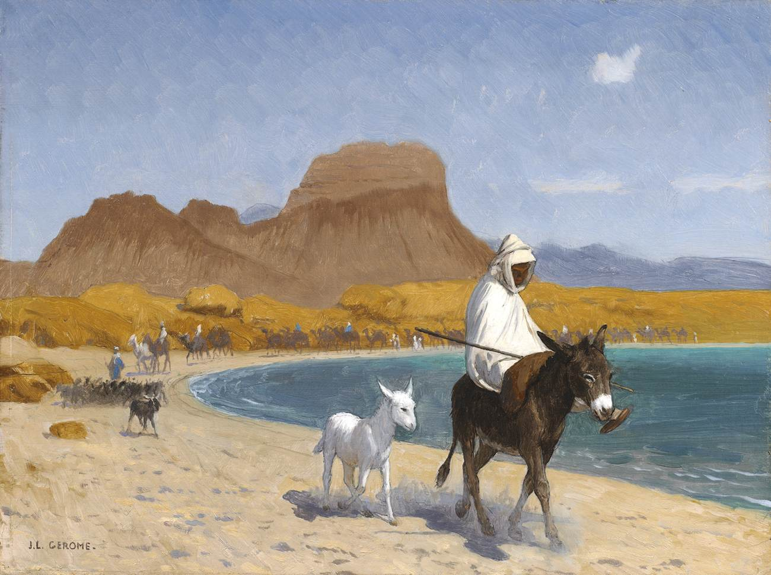
The Gulf of Aqaba
-
Oil on canvas,
27 x 36 cm
Private collection https://www.wga.hu/frames-e.html?/html/g/gerome/index.html

Slide 8
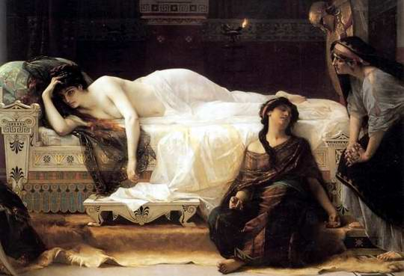
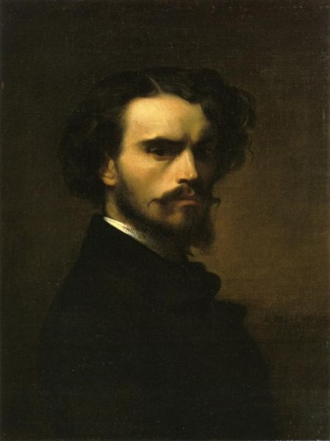
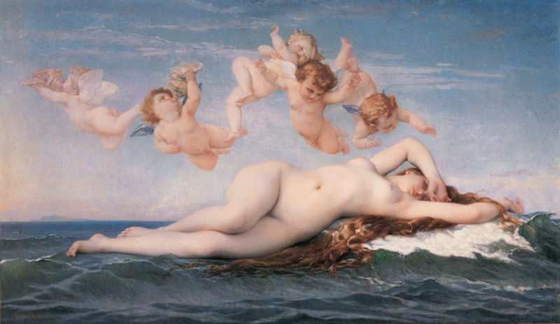
Alexandre Cabanel,
1823 – 1889

Slide 9
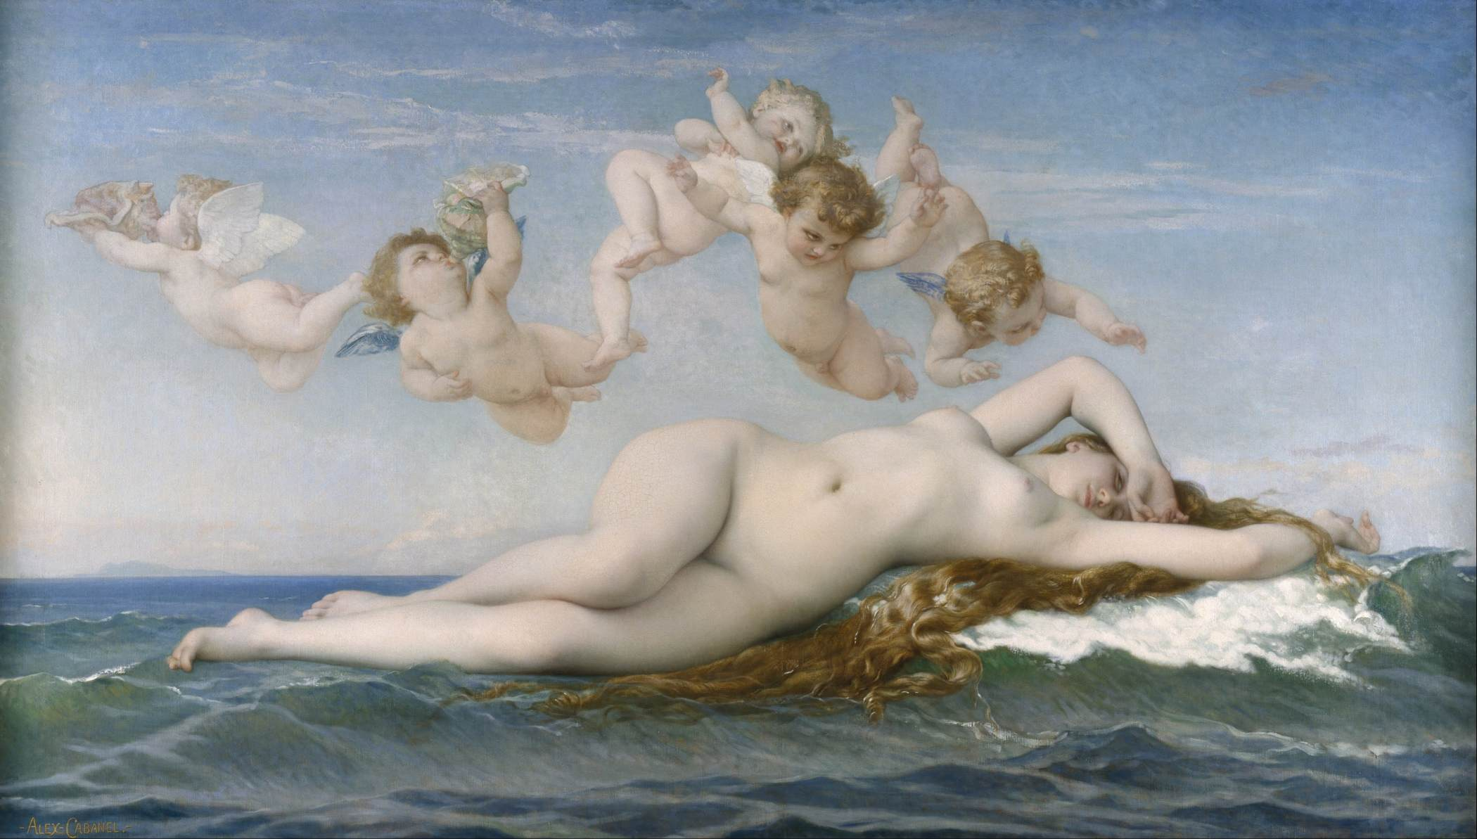
The Birth of Venus, 1863, Oil on canvas, 130 x 225 cm, Musée d'Orsay, Paris https://www.wga.hu/frames-e.html?/html/c/cabanel/index.html

Slide 10
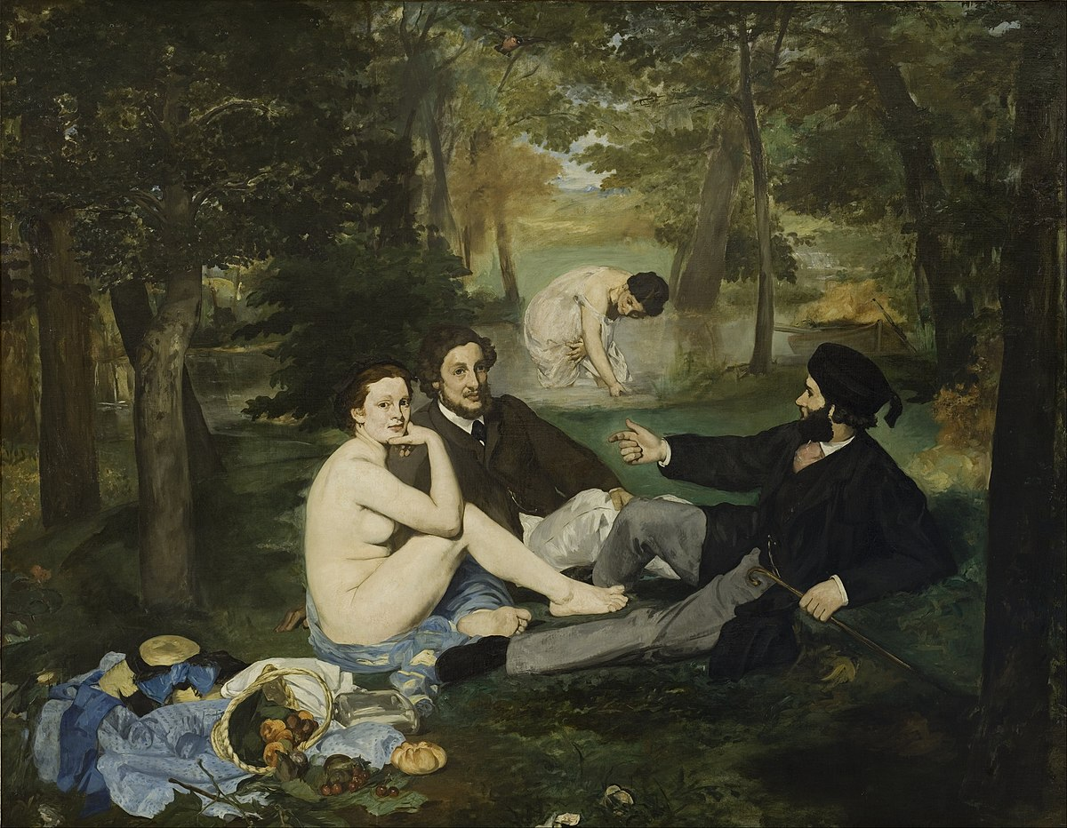

Slide 11
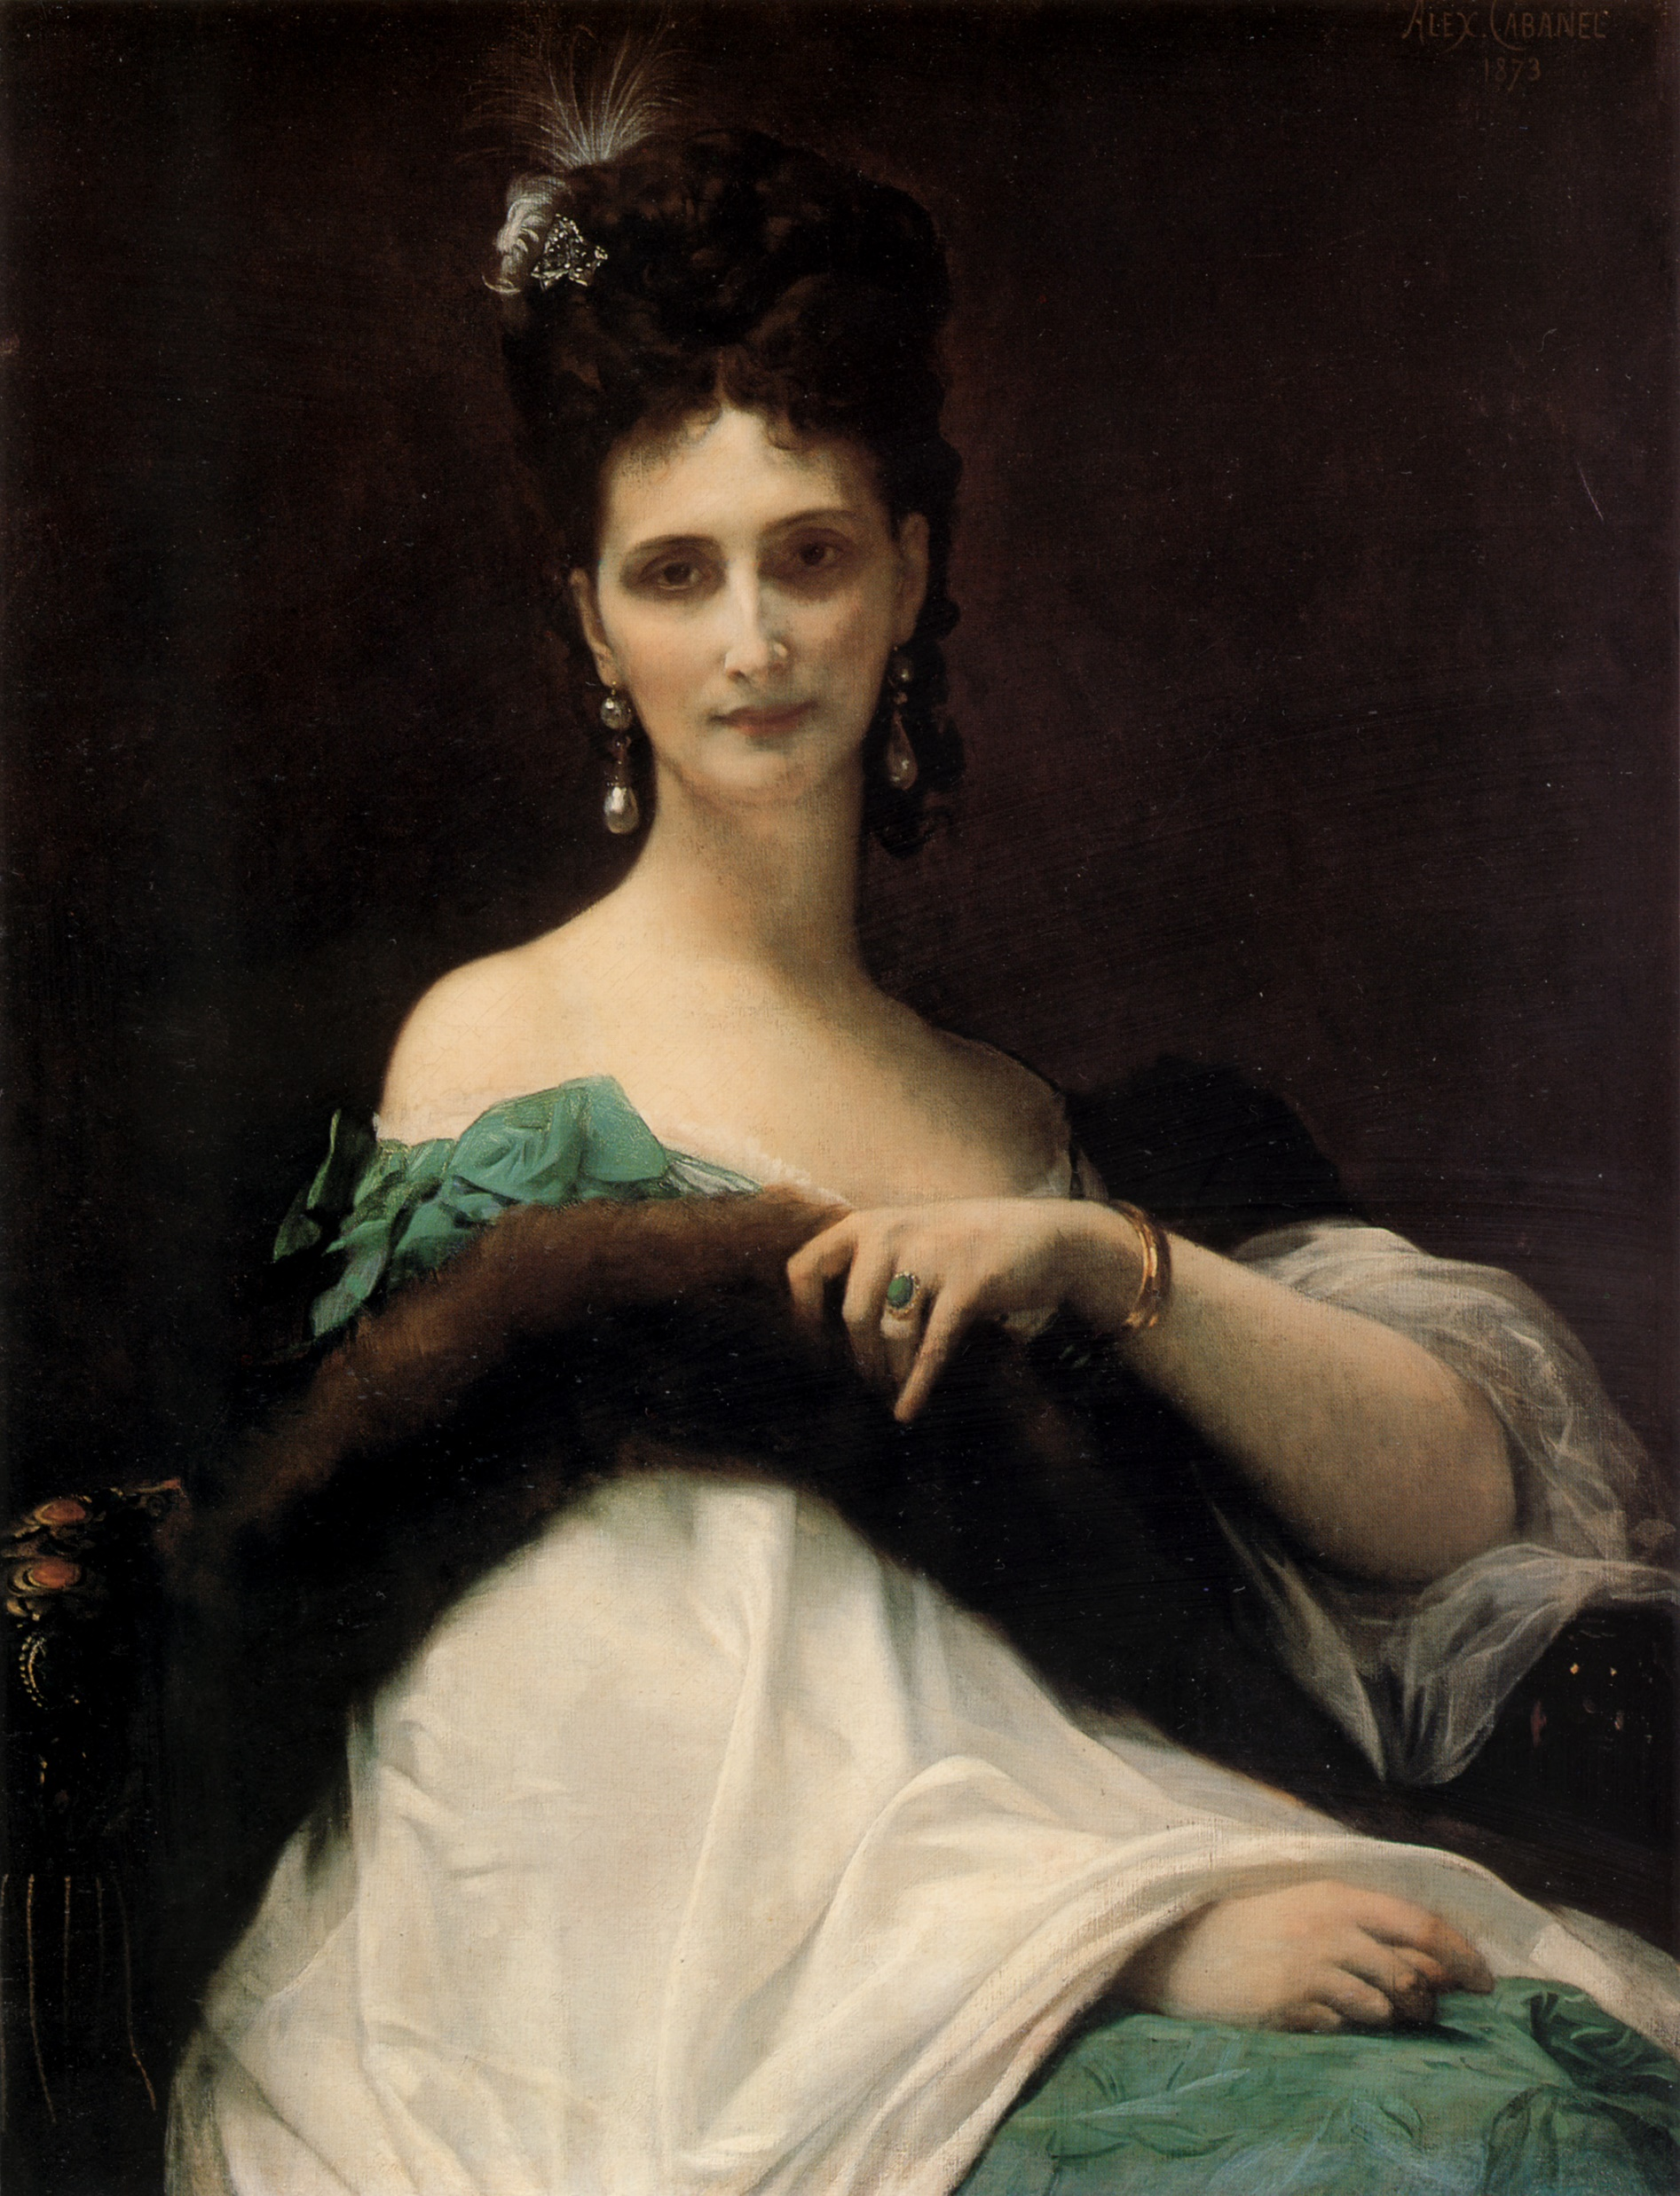
Portrait of the Comtesse de Keller c. 1873
Oil on canvas, 99 x 76 cm
The Hermitage, St. Petersburg https://www.arthistoryproject.com/artists/alexandre-cabanel/la-comtesse-de-keller/

Slide 12
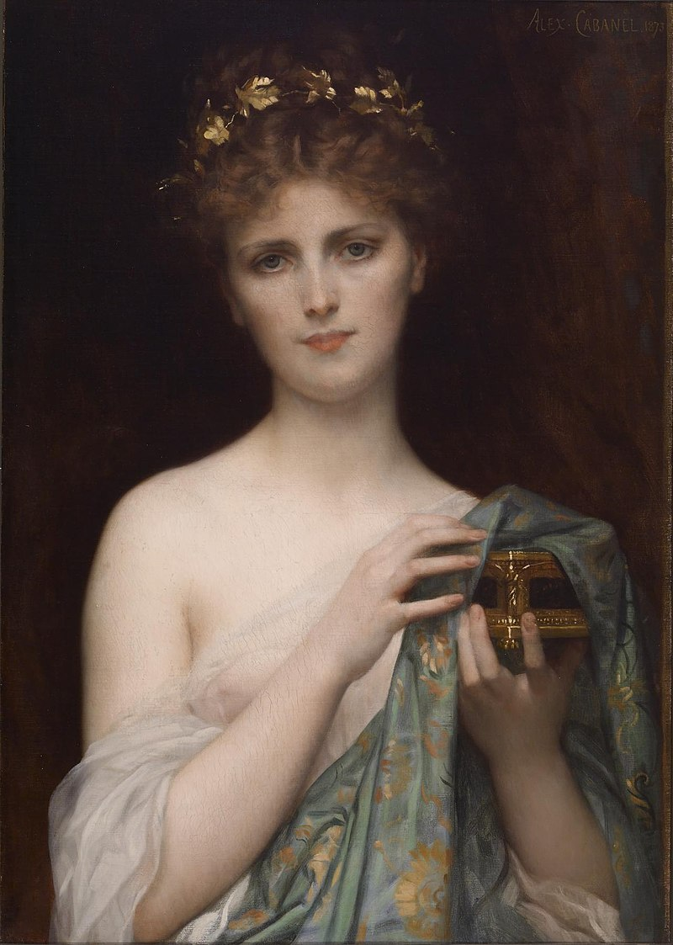
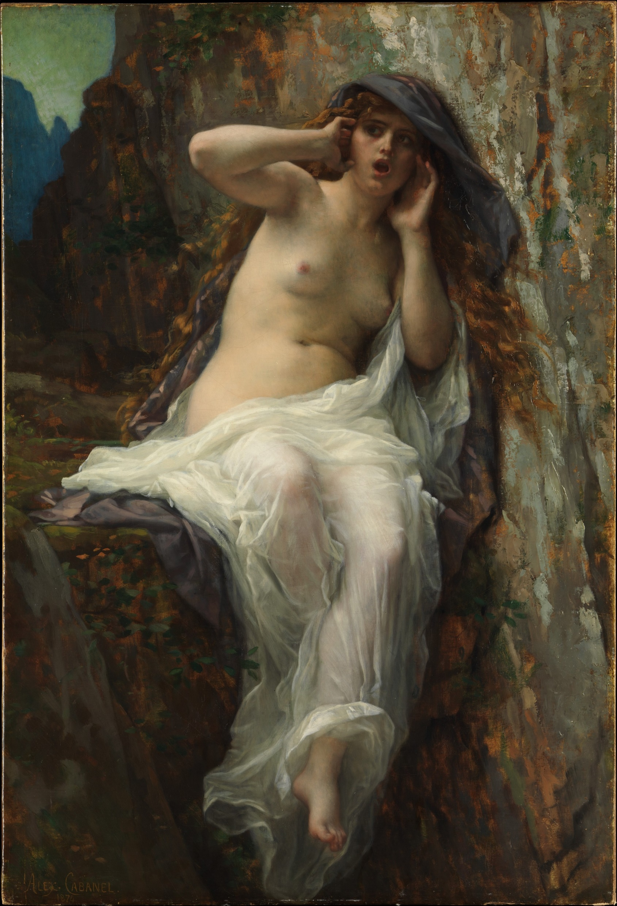
Pandora, 1873, Oil on Canvas, 70.2 x 49.2 cm, Walters Art Gallery, Baltimore, USA https://commons.wikimedia.org/wiki/File:Alexandre_Cabanel_-_Pandora_-_Walters_3799.jpg
Echo, 1874, oil on canvas, 97.8 x 66.7 cm, the MET, NY, USA https://www.metmuseum.org/art/collection/search/435829

Slide 13
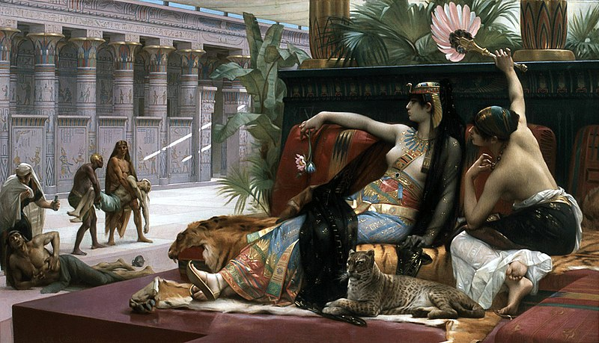
Cleopatra Testing Poisons on Condemned Prisoners, 1887, oil on canvas, 162.6 x 287.6 cm, Royal Museum of Fine Arts Antwerp https://commons.wikimedia.org/wiki/File:Alexandre_Cabanel_-_Cl%C3%A9opatre_essayant_des_poisons_sur_des_condamn%C3%A9s_%C3%A0_mort.jpg

Slide 14
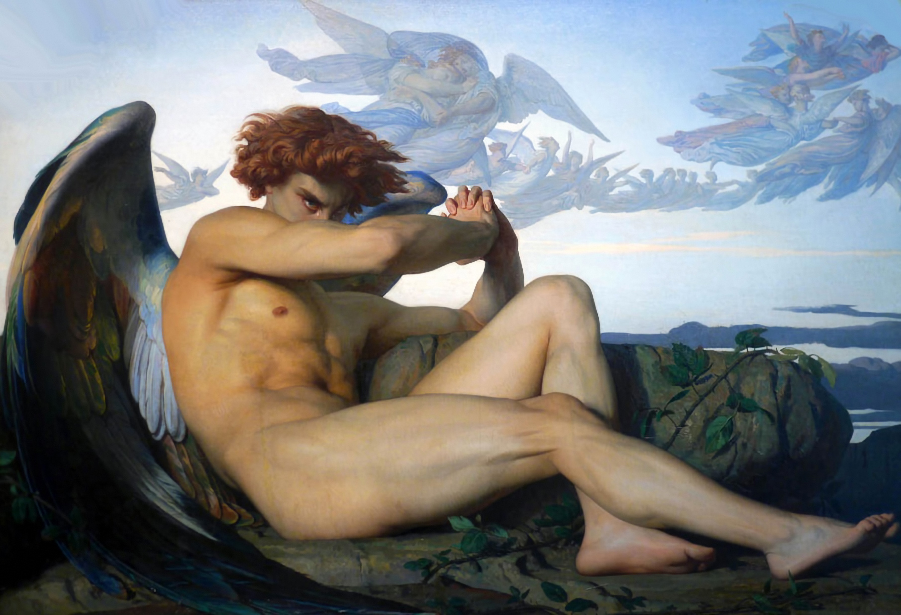
The Fallen Angel, 1847, oil on canvas, 120.50 x 196.50 cm, Musée Fabre, Montpellier, France https://en.wikipedia.org/wiki/The_Fallen_Angel_%28painting%29

Slide 15
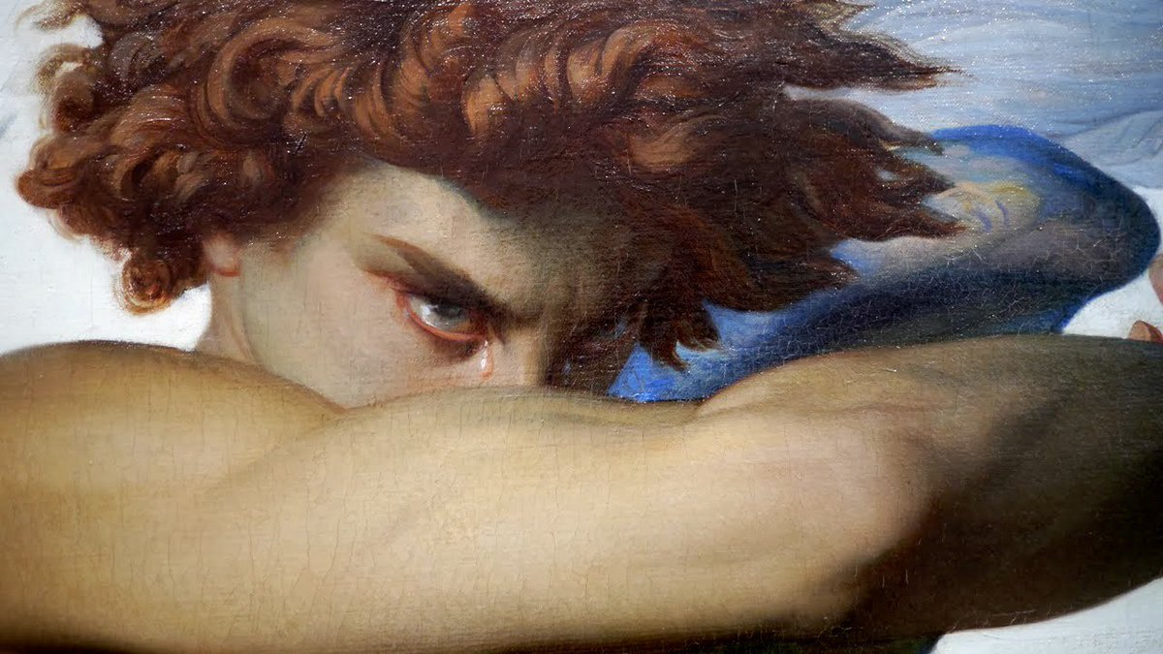

Slide 16
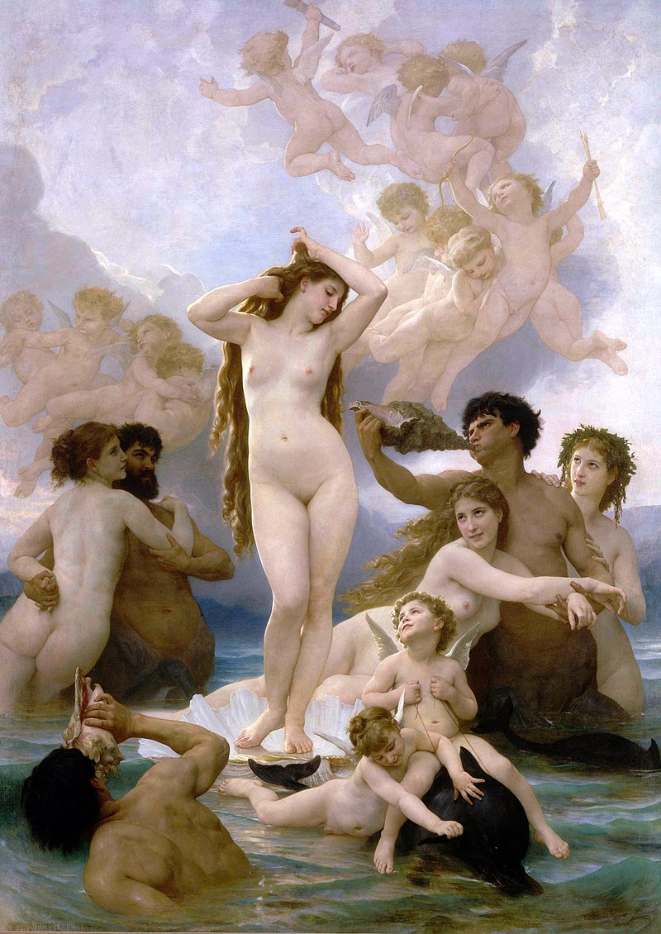
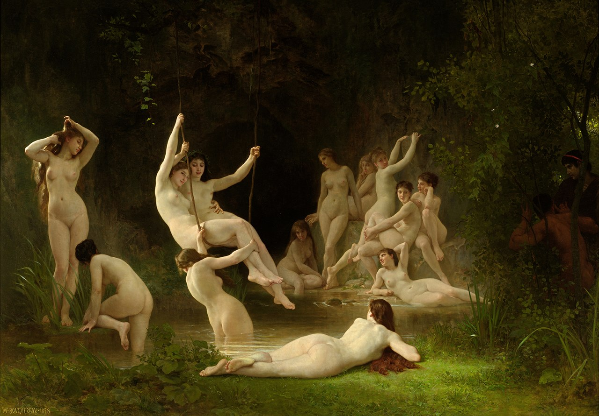
William-Adolphe Bouguereau, 1825 – 1905
The Nymphaeum, 1878, oil on canvas, 144.7x209.5 cm, Haggin Museum, CA, USA https://commons.wikimedia.org/wiki/File:William-Adolphe_Bouguereau_(1825-1905)_-_The_Nymphaeum_(1878).jpg
Birth of Venus, 1879, oil on canvas, 300 cm × 218 cm, Musée d'Orsay, Paris, France https://en.wikipedia.org/wiki/The_Birth_of_Venus_(Bouguereau)

Slide 17
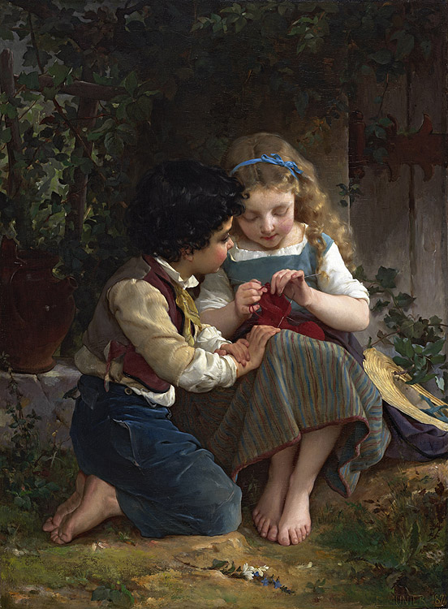
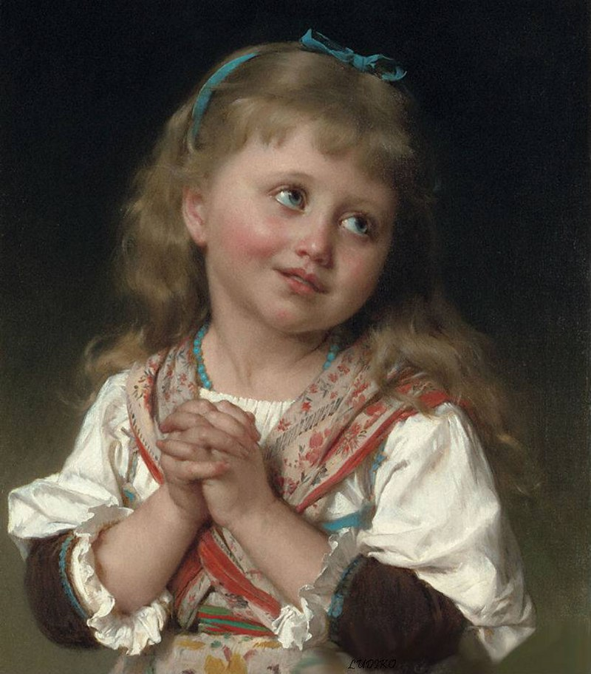
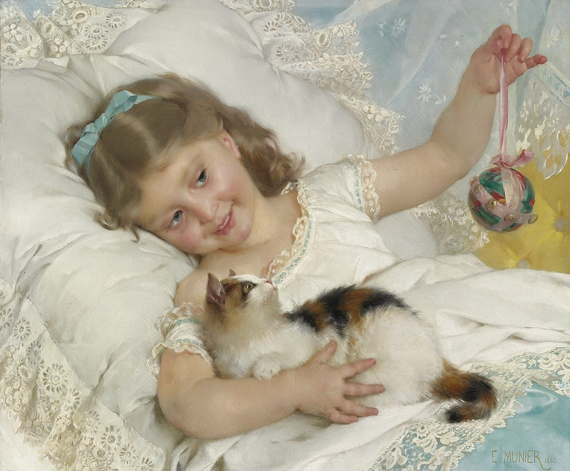
Émile Munier, 1840 – 1895
https://en.wikipedia.org/wiki/%C3%89mile_Munier

Slide 18
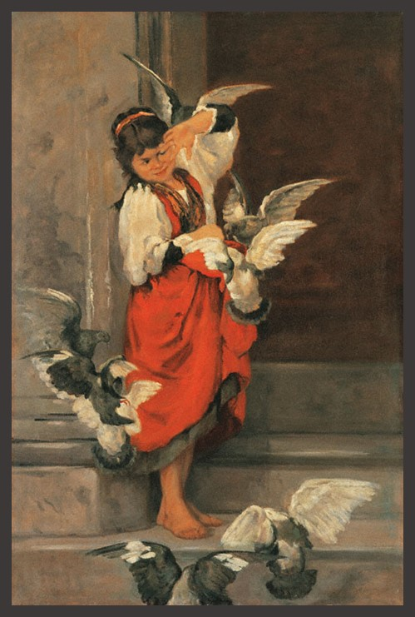
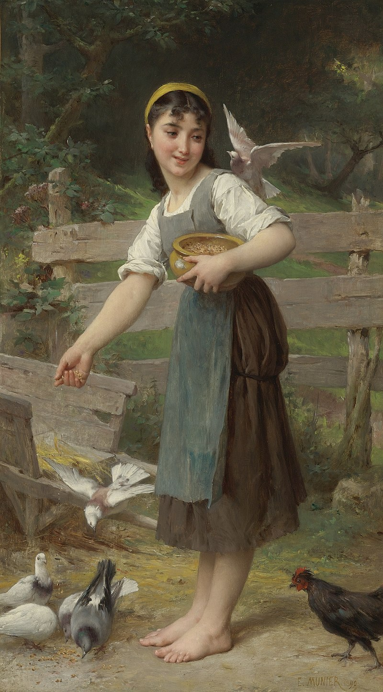
Polychronis Lembesis, Greek Artist, 1849-1913
The Girl with the Pigeons, 1879, Oil on Canvas, 120x80 cm, Averoff Museum of Neo-Hellenic Art, Metsovo, Greece https://www.averoffmuseum.gr/the-girl-with-the-pigeons/?lang=en
Émile Munier, 1840 – 1895 https://en.wikipedia.org/wiki/%C3%89mile_Munier

Slide 19
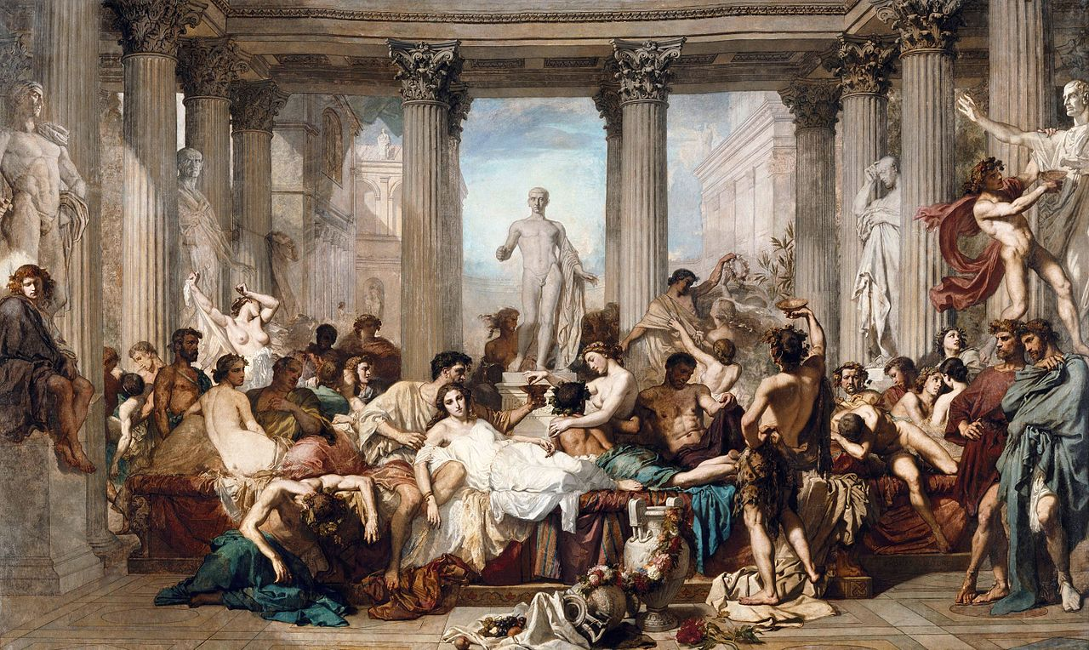
Thomas Couture, 1815 – 1879
Romans during the Decadence, 1847, oil on canvas, 472X772 cm, Orsay Museum, Paris, France https://commons.wikimedia.org/wiki/File:THOMAS_COUTURE_-_Los_Romanos_de_la_Decadencia_(Museo_de_Orsay,_1847._%C3%93leo_sobre_lienzo,_472_x_772_cm).jpg

